Slide 1
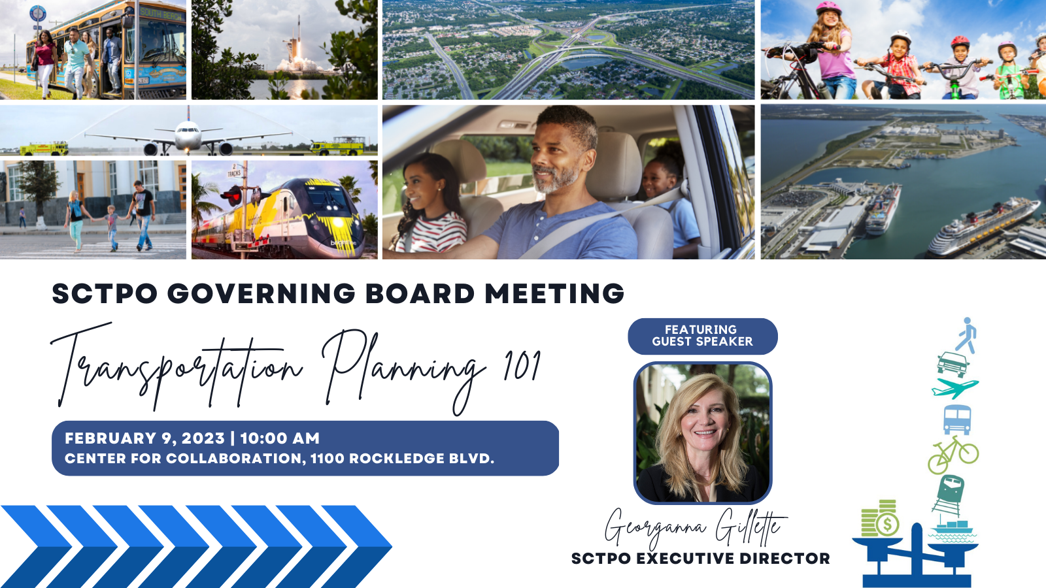
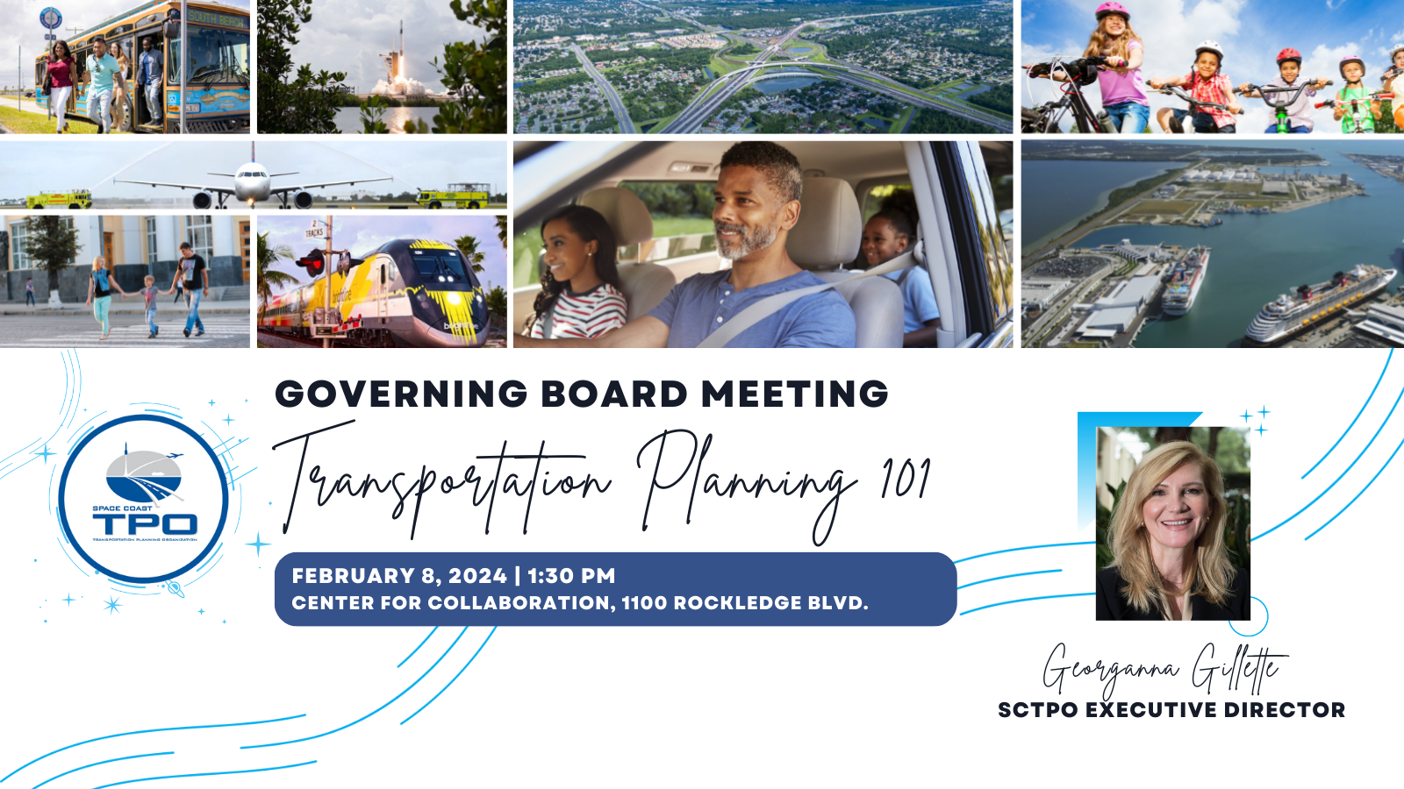

WELCOME
  Today’s Topics:
Meet the SCTPO Staff
Who Is the Space Coast TPO?
What does Transportation Planning Involve? - Core Work Products
SCTPO Resources
Projects and Funding – Accomplishments & Looking Forward
Members Roles - Getting Involved
Questions – Can be asked at any time!

Slide 2

Agenda
What is an MPO/TPO?
Who is the Space Coast TPO?
Governing Board & Advisory Committee Structure & Function
Core Work Products
Public Participation
Regional Coordination

Slide 3
FYI
  MPO = TPO
  A Metropolitan Planning Organization is the same as a Transportation Planning Organization.
  We use Space Coast TPO to express that we are on the Space Coast and do something with transportation.

Slide 4
What is a Metropolitan Planning Organization?

Slide 5
History of MPOs
Interstate Highways Program in 1940s & 50s
  National defense, commerce and trade,
  economic activity and job creation
Federal-Aid Highway Act of 1956
  Established the High ay Trust Fund
from federal fuel tax
  States, not cities, determined Interstate
plans – created destruction of communities
Notes:
1950s: The Emergence of the Interstate Highways Program. I want to focus on the most critical change in federal policy that launched a lot of spending and lead to a lot of other changes…and that’s the Interstate System. In 1956, 41,000 miles approved. Uncle Sam said, We need to dedicate revenue. They took federal fuel taxes and created what we call the highway trust fund. And for decades, that has been the primary source of funding for the “federal government” in providing funding for transportation.
Top: photograph taken sometime between 1955 and 1961 showing Florida Governor LeRoy Collins and President Dwight D. Eisenhower. Photographer unkwown. Photograph courtesy of Florida Photographic Collection. http://fpc.dos.state.fl.us/political/pt00606.jpg
Bottom: 1959 photograph entitled “Aerial view [of] an interstate highway: Polk County, Florida.” Photographer unknown. Photograph courtesy of Florida Photographic Collection. http://fpc.dos.state.fl.us/reference/rc17204.jpg

Slide 6
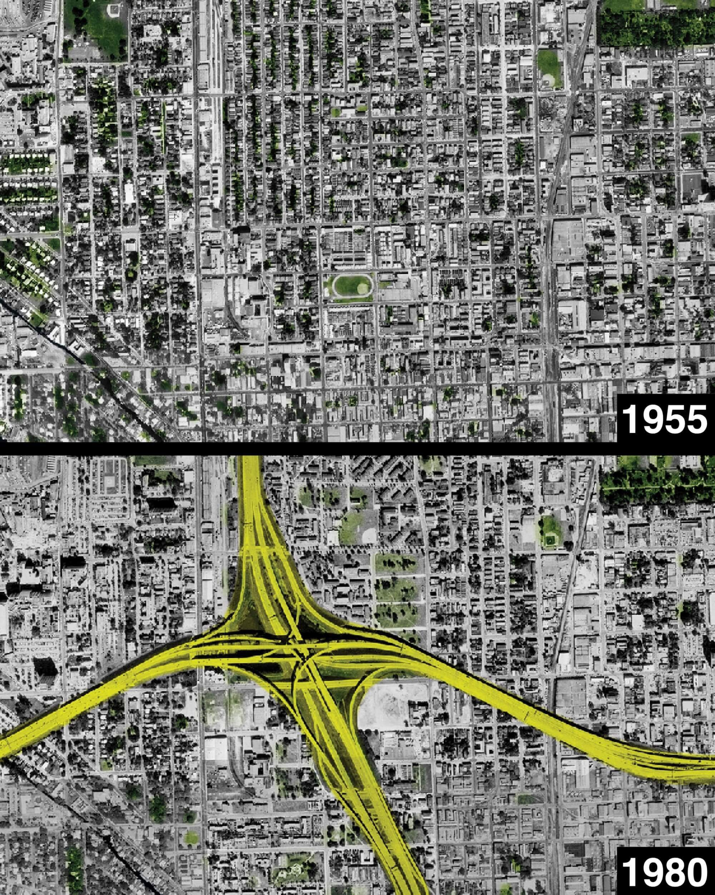
History of MPOs
Miami’s Overtown Neighborhood
  Neighborhoods bulldozed in the 1960s for the construction of I-95
  12,000 residents, nearly all Black, were forcibly displaced due to highway construction
Notes:
1950s: The Emergence of the Interstate Highways Program. I want to focus on the most critical change in federal policy that launched a lot of spending and lead to a lot of other changes…and that’s the Interstate System. In 1956, 41,000 miles approved. Uncle Sam said, We need to dedicate revenue. They took federal fuel taxes and created what we call the highway trust fund. And for decades, that has been the primary source of funding for the “federal government” in providing funding for transportation.
Top: photograph taken sometime between 1955 and 1961 showing Florida Governor LeRoy Collins and President Dwight D. Eisenhower. Photographer unkwown. Photograph courtesy of Florida Photographic Collection. http://fpc.dos.state.fl.us/political/pt00606.jpg
Bottom: 1959 photograph entitled “Aerial view [of] an interstate highway: Polk County, Florida.” Photographer unknown. Photograph courtesy of Florida Photographic Collection. http://fpc.dos.state.fl.us/reference/rc17204.jpg

Slide 7
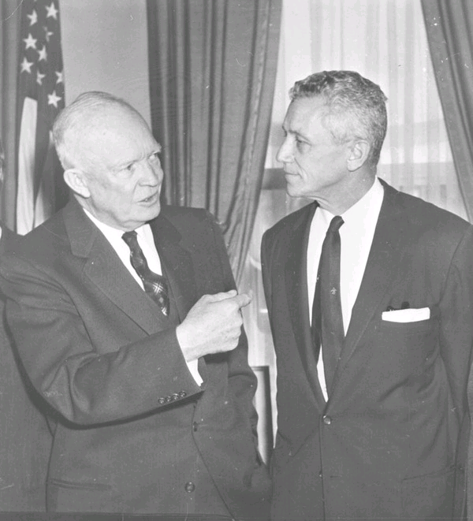

History of MPOs
Transit
Cities took over transit services to avoid bankruptcy or closure
First federal support for transit – Housing Act of 1961
This supported metro-level planning
Federal-Aid Highway Act of 1962
Continuous, Comprehensive, Cooperative
Civil Rights Act of 1964
Mandates nondiscriminatory conduct in all federally-supported programs
National Environmental Policy Act of 1969
Environmental impact consideration mandated

Slide 8
History of MPOs
Federal-Aid Highway Act of 1973
Mandated Metropolitan Planning Organizations (MPOs) for urban areas with more than 50,000 people
A portion of Highway Trust Fund dollars is allocated to MPOs for planning
Brevard MPO formation October 19, 1977
Intermodal Surface Transportation Efficiency Act of 1991
Created requirements for planning documents and authority for decision-making

Slide 9

History of MPOs
Fixing America’s Surface Transportation (FAST) Act of 2015
Created requirement for performance-based planning, now called “Performance Measures”
Added freight as a priority
Transfers funds from General Fund to Highway Trust Fund
Bipartisan Infrastructure Law
Enacted November 15, 2021
$550B in new investments like transportation, water, broadband and energy
Notes:
That brings us to the most recent federal authorization, passed in November 2021. It provides five years of funding certainty for transportation. There is a policy priority on performance-based planning. We have to quantify the impact on the investments we make on the effectiveness of the transportation system. Emphasis on freight, movement of goods on intermodal facilities.
Transportation funding has relied upon fuel tax revenues pretty exclusively,
long-term challenges associated with our historical reliance on the gas tax.
Gax tax revenues have not kept pace with the rising costs of preservation of our transportation infrastructure, as well as the rising costs of new projects. The long-term trend toward higher fuel costs, more fuel-efficient vehicles, and alternative sources of energy for transportation, simply add to the gap between costs and revenues. We have an unsustainable means of meeting the nation’s transportation

Slide 10

How Are We Established in Federal Law?
Federal Law –
  23 USC 134 contains most of the authority and responsibility of MPOs
    Areas >50 K pop. must have TPO to spend Federal transportation funds
    Metropolitan areas >200K are Transportation Management Areas
    Board sets big-picture framework for transportation decisions
    Board has direct authority for TPO plans and programs required to keep transportation funds moving
    Must consider all MODES and involve the public in planning and programming
    Federal certification required
Notes:
We are a federally designated agency / consists of board members, committee members, TPA staff and public stakeholders
Provides local elected officials input into the planning and implementation of federal transportation funds.

Slide 11
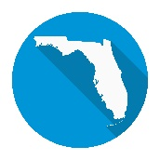
How Are We Established In Florida?
State Law –
  Florida Statutes Chapter 339.175
    Governor approves membership plan based on latest Census
    Maximum 19 members on Space Coast TPO Governing Board
    All members (except County Commissioners) allowed one alternate
    Establishes Required Advisory Committees
    Project selection and funding process
Notes:
Most of the language concerning MPO structure, authority, and responsibility is in 23 United States Code 134.

Slide 12
Who is the Space Coast TPO?

Slide 13
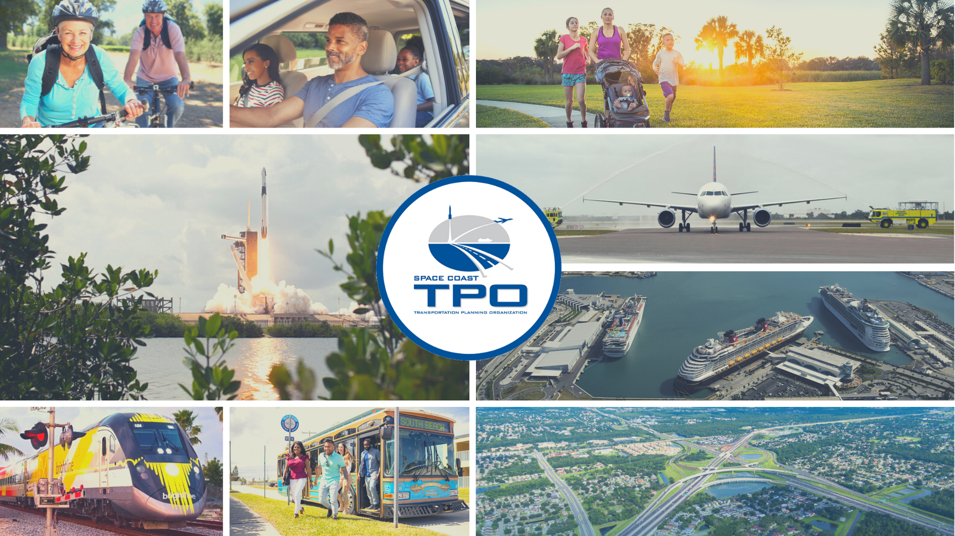
Notes:
MISSION STATEMENT:
To plan a transportation system that enhances quality of life and economic development by engaging the community.
VISION:
Provide a safe, multimodal, innovative, and resilient transportation system for all.
Coordinate and communicate with other modal agencies.
Influence of each mode transcends jurisdictional boundaries; example growth of Port leads to need for the Beachline to be widened. Someone needs to be looking at the big picture. Coordinating and planning among the modes.
Roads don’t stop at city limits or county line. User doesn’t care who owns the road, they just want to get where they’re going safely and in a reasonable, dependable time.
So it’s critical we view transportation holistically and that we talk to each other about how to improve it. The TPO is a forum where those discussions can occur.
We are involved in planning everything from sidewalks to spaceports. This makes us a quintimodal agency, planning for transportation by all these modes. In addition, we also plan for non-motorized transportation through an expanding network of bicycle and pedestrian trails.
To review other agencies’ planning and programming decisions
--------------------------------------------------------------------------------------------------------------------------------------------------------------------------------------------------------------

Slide 14
Who Is The SCTPO?
Organized by Interlocal Agreement between Brevard local governments, Port Canaveral, FDOT
Independent organization
Contract with Board of County Commissioners for admin support and benefits

Slide 15
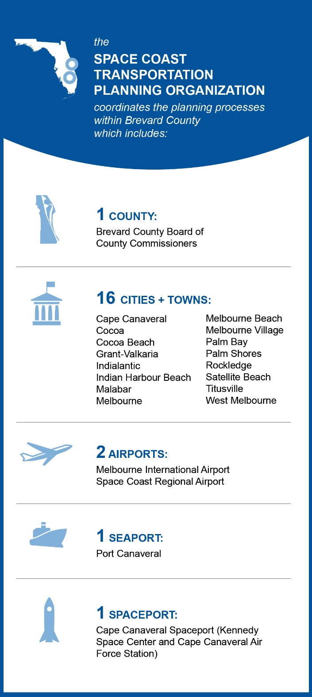
Who is the Space Coast TPO?
Approve more than $1B of federal and state transportation dollars to implement projects
Governing Board is supported by staff and advisory committees
Role of the TPA Governing Board
Sets the “big picture” framework for transportation decisions
Make planning and programming decisions
Direct authority for TPO plans and programs

Slide 16
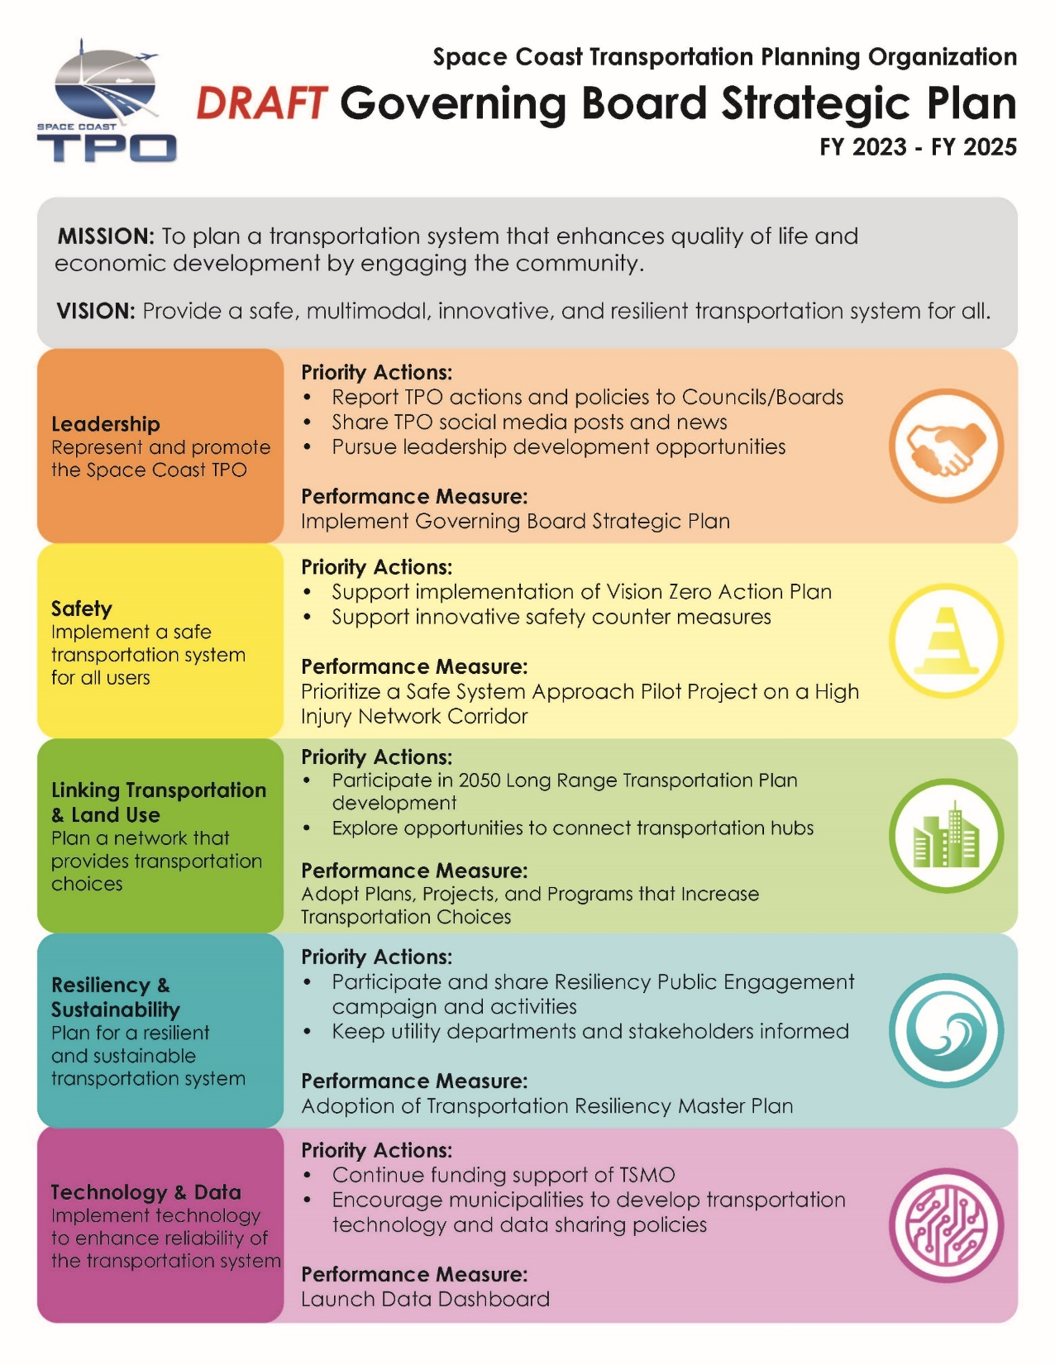
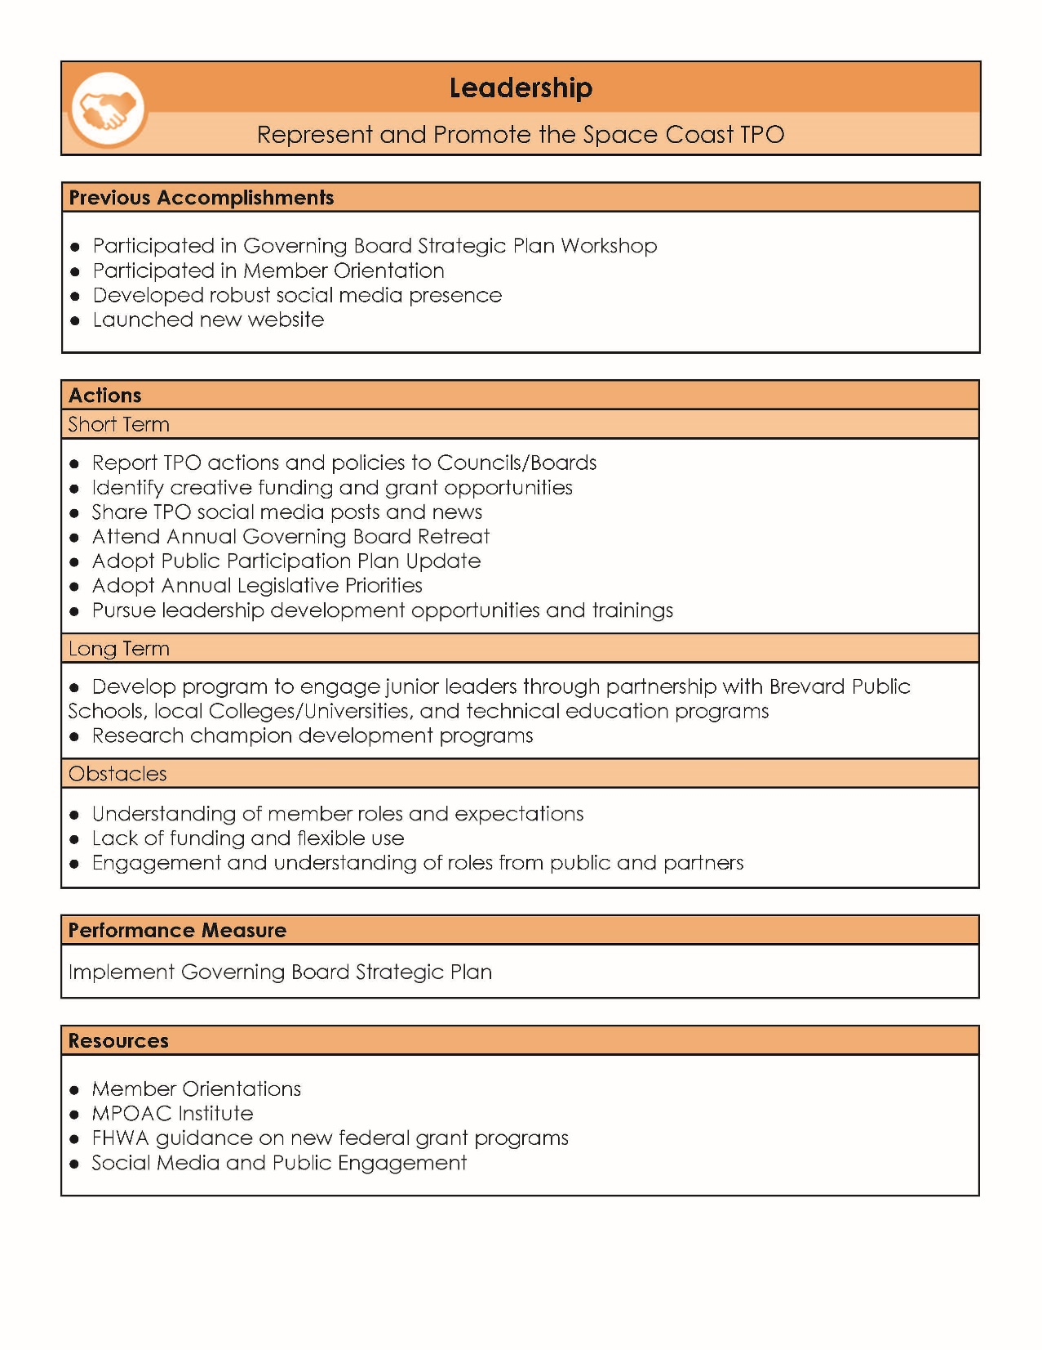
Notes:
5 emphasis areas to focus our efforts on. Each area has a goal, strategies, tactics, and performance measures. We are now going to go through each emphasis area for input and feedback. If you are a Board member that serves on various boards, remember the policy decisions that you make as a TPO members. Land use decisions. If you made a decision last week at the TPO, but now the council / commission is thinking about making another decision that directly conflicts. Foster that interagency communication. You wear more than one hat.

Slide 17

Space Coast TPO
Member Role

Slide 18
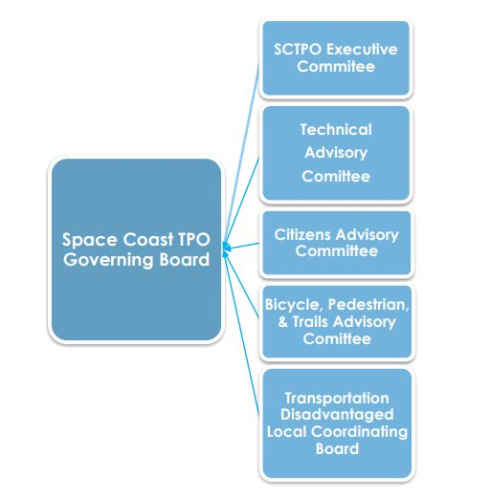

Who informs our process?
*Sunshine Law applies to
ALL
SCTPO Governing Board and Committee Members
Notes:
Organizationally, we have four advisory committees to the TPO Governing Board: the Bicycle, Pedestrian, and Trails Advisory Committee, the Citizen’s Advisory Committee, and the Technical Advisory Committee. The Executive Committee reviews in detail key transportation policy and administrative issues of concern to the TPO. Public Involvement is encouraged throughout the process. Let’s take a closer look at each Committee.
--------------------------------------------------------------------------------------------------------------------------------------------------------------------------------------------------------------

Slide 19
Operating Policies & Procedures
Facilitates efficient conduct by the TPO
Outlines roles and functions of the Governing Board and advisory committees
Meeting guidelines, emergency powers and TPO authority

Slide 20

Technical Advisory Committee
Responsibilities
Purpose: To provide technical input on plans, programs and projects and to evaluate the technical acceptability of each. Recommendations are forwarded to SCTPO Board for consideration.
Notes:
Board members are making the decisions. TAC members represent modal agencies and local governments with specific expertise related to transportation planning. Input from your professional point of view. We are looking for professional input. We’ve had TAC members in the past that have had very strong opinions about things, but are you hear to give your personal opinion or your professional opinion. Because that’s why you are hear. You make recommendations to the TPO Board
--------------------------------------------------------------------------------------------------------------------------------------------------------------------------------------------------------------

Slide 21

Citizen Advisory Committee
Responsibilities
Purpose: To provide citizen’s views on projects, plans, and programs. Recommendations are forwarded to SCTPO Board for consideration.

Slide 22

Bicycle, Pedestrian, & Trails
Advisory Committee Responsibilities
Purpose: To review plans and policies regarding bicycle, pedestrian and multi-use trail projects and make recommendations to the CAC, TAC, and SCTPO Governing Board.

Slide 23

Transportation Disadvantaged Local Coordinating Board
Purpose: To identify local service needs for the transportation disadvantaged pursuant to Chapter 427.0157 F.S.
  State-mandated Independent Committee
  Oversees state Transportation Disadvantaged program in Brevard
TDLCB administered by Space Coast Area Transit

Slide 24
Core Work Products

Slide 25
Relationship Between Core Products
Long Range Transportation Plan
Project Priorities
Transportation Improvement Program
Unified Planning Work Program

Slide 26
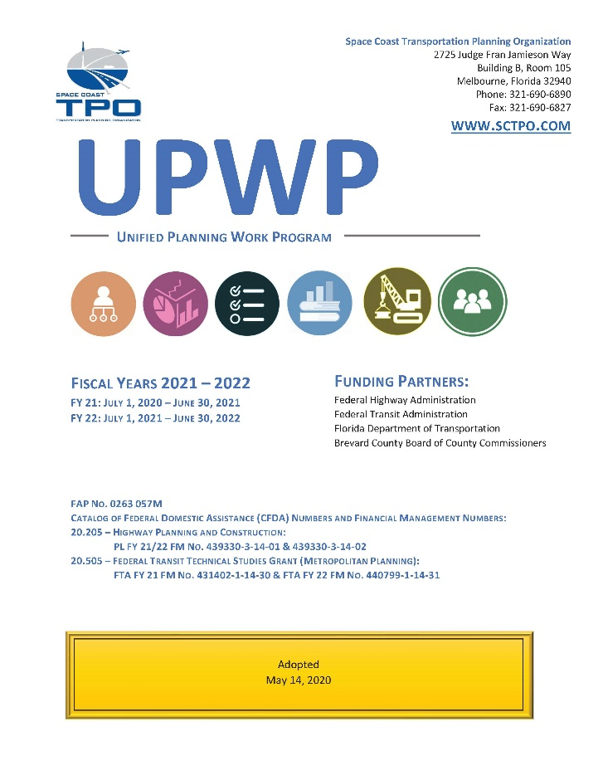
Unified Planning Work Program
Unified Planning Work Product
2-Year Agency Operational Plan & Budget
  (July 1, 2022 – June 30, 2024)
Defines work products to be produced and timeline
Funded with Federal Highway and Transit Planning Grants

Slide 27
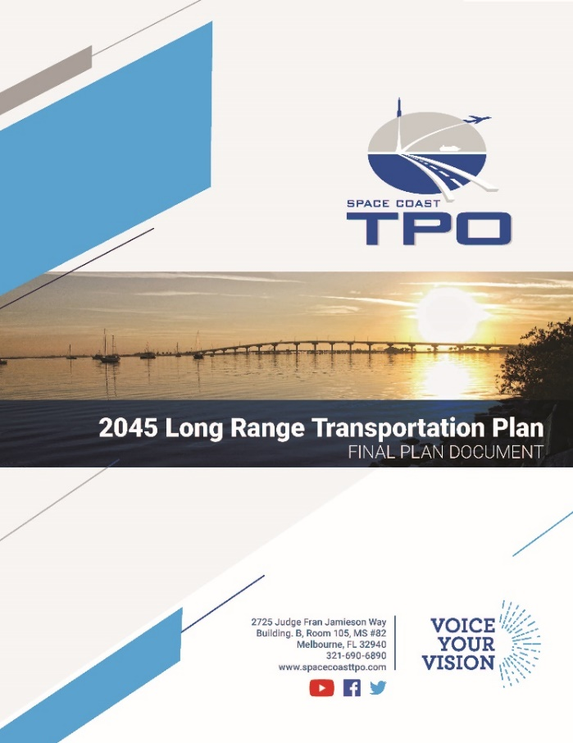
Long Range Transportation Plan
  Federal Requirements
Sets a vision for the region, strategies, and projects to achieve it
Looks forward 25 years
Considers all transportation modes
Reflects public involvement
Contains a fiscally constrained financial plan
Performance based
Updated every 5 years, amended anytime
Notes:
The Long Range Transportation Plan is the most important planning document produced by the TPO. It is the cornerstone upon which all transportation decisions in the region should be based. This is where you set your vision. We put in policies and operational strategies to achieve it. At least to the extent that you can afford it….which is always the rub. If a major project does not appear in the TPO’s LRTP, it cannot receive federal funding. It’s as simple as that.
The LRTP must provide a vision for the future of the metropolitan area, identify future transportation demand in the metropolitan area and provides the framework for choosing transportation projects. Not every TPO will have the same combination of projects, but each must consider a full mix of transportation options when developing their LRTP.
The LRTP must contain a financial plan and be fiscally constrained. In other words, the TPO Board must be financially realistic in developing the LRTP. The TPO must decide what year or band of years a specific project in the plan will be implemented and estimate the future project cost. Reasonable available revenue. Is it reasonable to anticipate a ½ penny or penny sales tax….probably depends on your area. We need to know our local context to know that. It is expressed in year of expenditure…dollars in the year that you will do project. Inflation factor from FDOT – You do the best you can. You also have to decide when is the project going to happen. That’s the hard part. It must also be performance based and integrate the goals, objectives, performance measures and targets described in other state transportation plans.
A project cannot be added to an LRTP without an identified funding source or without room being made by removing projects of equal or greater cost. It affect federal planning factors and public involvement. What modes of transportation does it consider? ALL modes.
--------------------------------------------------------------------------------------------------------------------------------------------------------------------------------------------------------------

Slide 28
Long Range Transportation Plan
State Requirements
Must “give emphasis to” facilities of national, state, and regional significance
  Strategic Intermodal System (SIS)
Must reflect the goals of the Florida Transportation Plan (FTP)
Must be consistent with local comprehensive plans
Must reflect coordination among MPOs on facilities crossing MPO boundaries

Slide 29


List of Project Priorities
  Project ideas requested from County, local municipalities and transportation providers every spring
  Projects reviewed by Committees and Staff
  Prioritized list is sent to Florida Department of Transportation (FDOT) for funding consideration
The SCTPO only reviews projects eligible for state and federal funding. Local roads are the responsible of the local municipalities.
Notes:
Transportation planning is a bottom-up process that begins with local elected officials.
Every spring, the TPO requests project ideas from municipalities, the County, and transportation providers. This year’s call for projects is currently open. Only projects seeking State and Federal funding are prioritized. Local projects are the responsibility of the governing body where the project is located.
Potential projects must be in line with the Long Range Transportation Plan. Projects are reviewed by TPO Committees and citizens. A draft prioritized list is submitted to the TPO Board for consideration. Once adopted, the list is forwarded to the Florida Department of Transportation (FDOT) for consideration.
--------------------------------------------------------------------------------------------------------------------------------------------------------------------------------------------------------------

Slide 30
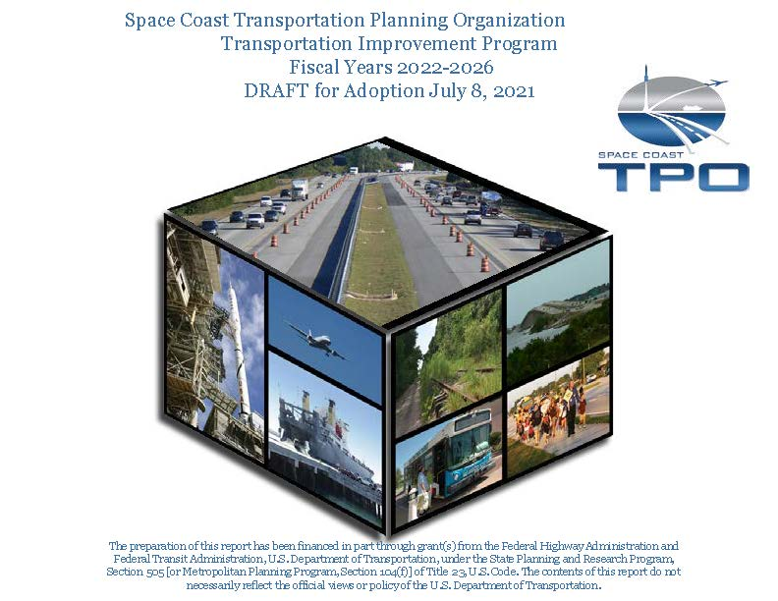
Transportation Improvement Program
Staged, multi-year, intermodal program of transportation initiatives
Provides five-year implementation schedule
(FY 24– FY 28)
Fiscally constrained
Consistent with the LRTP, local comprehensive plans, and local modal plans
Total Funding:
131 Projects - $1,305,967,572
Notes:
Project Programming
WHERE PLANNING MEETS THE MONEY
The most important TPO annual action
Goal is to move projects from concept to construction
Complex process
Funds are categorical with many rules
There are two primary products that result from the TPOs programming responsibilities – a List of Priority Projects (that we just discussed) and a Transportation Improvement Program or TIP. The Transportation Improvement Program (or TIP) lists each transportation project by phase to be implemented over the next five years. The TIP focuses on the nearer term elements of the LRTP. Like the LRTP, It must be affordable with reasonably-expected resources, and must be performance-based. How the projects in your TIP are meeting the performance goals….safety, etc. We should have a pretty good idea of the cost.
Federal and State law require that the TIP be consistent with the LRTP. The TIP should be consistent, with local comprehensive plans and the plans of local modal agencies such as seaports, airports, expressway authorities and transit agencies. In FY 2017, there is approximately $220 Million programmed in State and Federal Funds in Brevard County.
Federal law requires the TIP to include a description of the anticipated effect of the TIP toward achieving the performance target. If there is a project in the DOT work program and it is not included in the TIP or the statewide TIP (STIP), it cannot receive federal funds. So this is why you will see TIP amendments come before you at meetings. TIP has a narrative…..
--------------------------------------------------------------------------------------------------------------------------------------------------------------------------------------------------------------

Slide 31

Public Participation Plan
A Blueprint for Public Engagement
Describes SCTPO public involvement and engagement tools and strategies
Notes public comment periods for required work products
Offers opportunities for public participation to help guide the planning process
Adopted every three years – Adopted December 2022
Notes:
Establishes multimedia strategies to show how the TPA plans to engage with the public
Includes meeting notices, social media, printed materials, outreach activities, etc.
First task in the UPWP and TPA’s Strategic Plan
Federally required document
Updated in January 2023, currently under public review until March 16
The TPA manages accounts for Facebook, Instagram, Twitter, LinkedIn and YouTube
@PalmBeachTPA
Strategic Plan goals to increase followers and engagement
Gained more than 1,700 followers since tracking started in July 2021
Increased average monthly impressions to 31,369 per month
Monthly Public Involvement Activity Reports (PIAR) show SP Goal progress

Slide 32



SCTPO Resources: Plans
  Sea Level Rise Analysis – Feb 2018
  ADA Bus Stop Analysis – Dec 2018
  Bicycle & Pedestrian Master Plan – Nov 2019
  Vision Zero Action Plan – Update 2024
  Intelligent Transportation System Master Plan – 2021
  Transportation Resiliency Master Plan – 2022

Slide 33
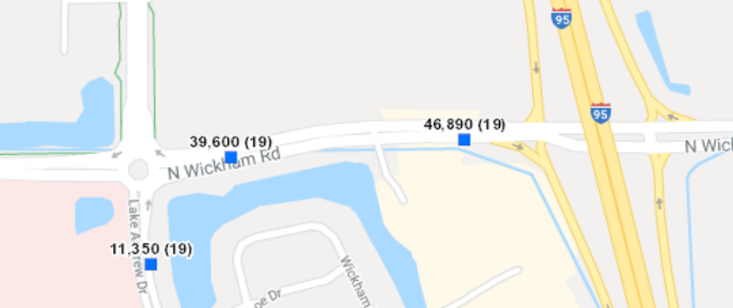

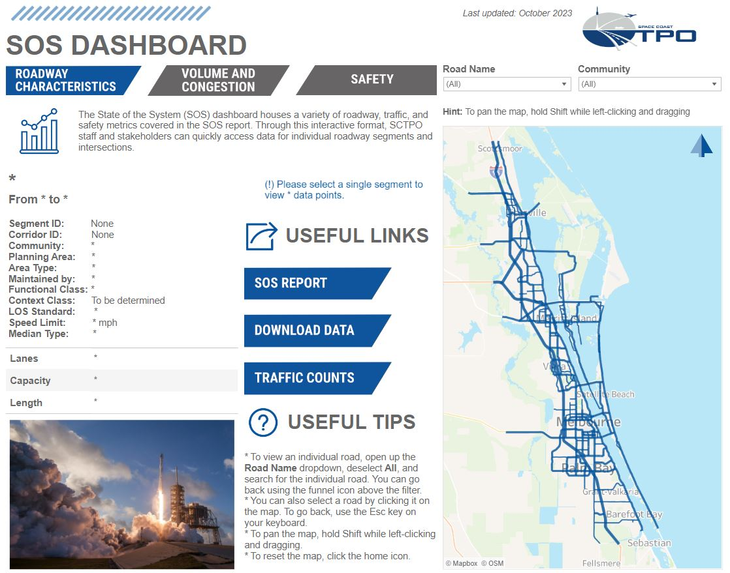
SCTPO Resources: Data
  Data
    Traffic counts
    Crash data base
    Performance Measures
    State of the System Interactive Dashboard

Slide 34

Looking Forward
  Cocoa Intermodal Station Feasibility Study – Underway
  Southern Brevard Trails Master Plan – Underway
  Vision Zero Action Plan Update
  2050 Long Range Transportation Plan & Transit Development Plan
  Mobility on Demand Study
  Dixon Blvd Complete Street
  North Merritt Island Pioneer Trail
  Grant Development: Ellis INFRA & Brevard Rail Safety Improvements

Slide 35
Regional Coordination

Slide 36
Central Florida MPO Alliance
Central Florida MPO Alliance
– 6 MPOs, 4.9 million people
“Market” larger than a single entity
Common issues
Improved chances for success
Adopts a Regional Priority List of Projects
Marion
Volusia
Lake
Sumter
Seminole
Orange
Osceola
Polk
Brevard
Notes:
We also have to think regionally. Our market is larger than a single entity. Brevard is part of the Orlando market area. We are dependent on Orlando and they in turn rely on us. We have several features here that are economic engines for the entire region – KSC, Patrick AFB, the beaches, Port Canaveral . Need good REGIONAL Connectivity for tourism, goods movement, access to Orlando area facilities and access to Brevard’s regional facilities.
The Space Coast TPO is a member of the Central Florida MPO Alliance – 6 MPO forum along with FDOT. We meet quarterly. One of the most significant items we’ve accomplished is the development of a Regional List of Transportation projects; Coast to Coast Trail, Regional Studies.

Slide 37
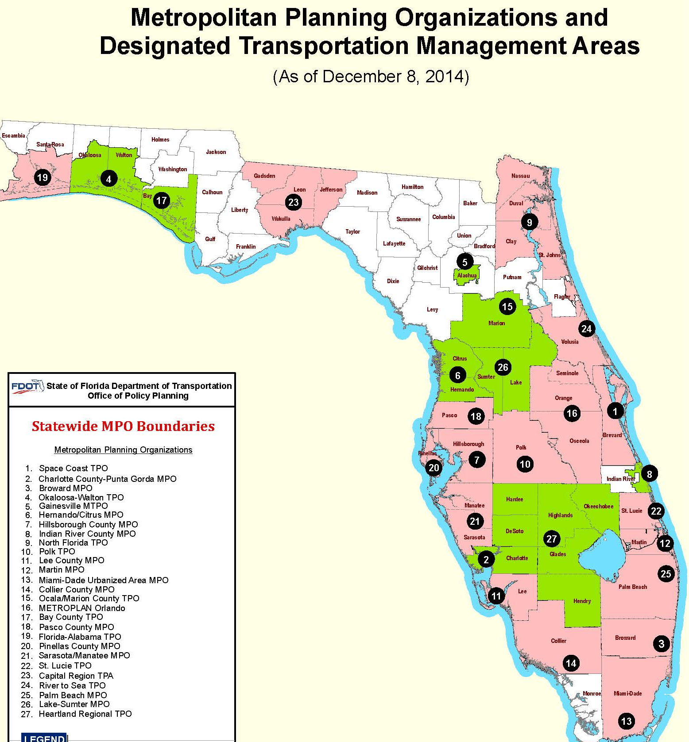
Metropolitan Planning Organization Advisory Committee
27 MPOs in Florida
  Meets Quarterly
MPOAC Governing Board
  1 SCTPO Member; 1 Alternate
MPOAC Staff Director’s Committee
Notes:
Statewide Meeting – Florida Metropolitan Planning Organization Advisory Council – includes all 27 MPOs in the State of Florida.

Slide 38
General Member Information

Slide 39

General Member Information
Read and review agenda packages prior to meeting
Sign-in at every meeting
If you cannot attend, your responsibility to contact alternate
  The member roster and email addresses can be found under “Board & Committees” on sctpo.com
Change of contact info: Inform Board Services Administrator
Report back on topics to your agency/council/commission
All TAC, CAC, TPO meetings are recorded, live streamed on YouTube/Facebook
Governing Board meetings streamed live on SCGTV

Slide 40
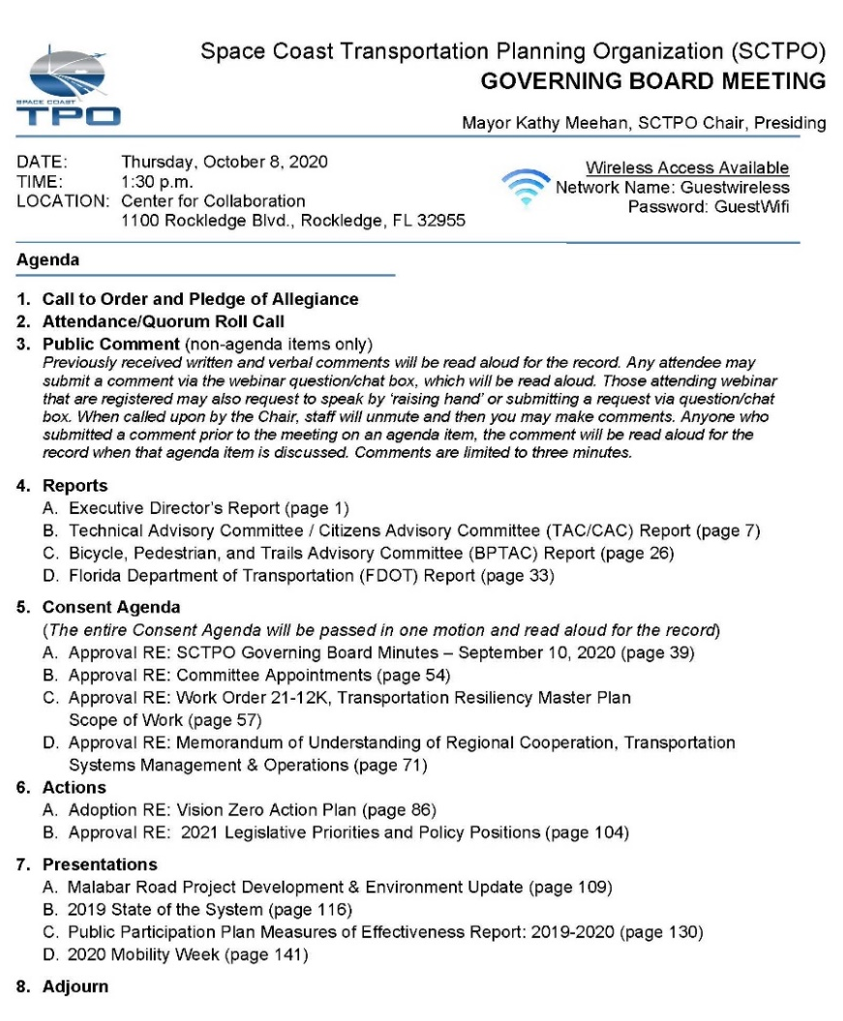

Agenda Format
The agenda is broken up into various categories such as reports, consent agenda, actions, and presentations.
Consent items will include as much administrative items as possible.
Please call the SCTPO or responsible staff member if you have questions. Any consent item may be pulled for further discussion.

Slide 41
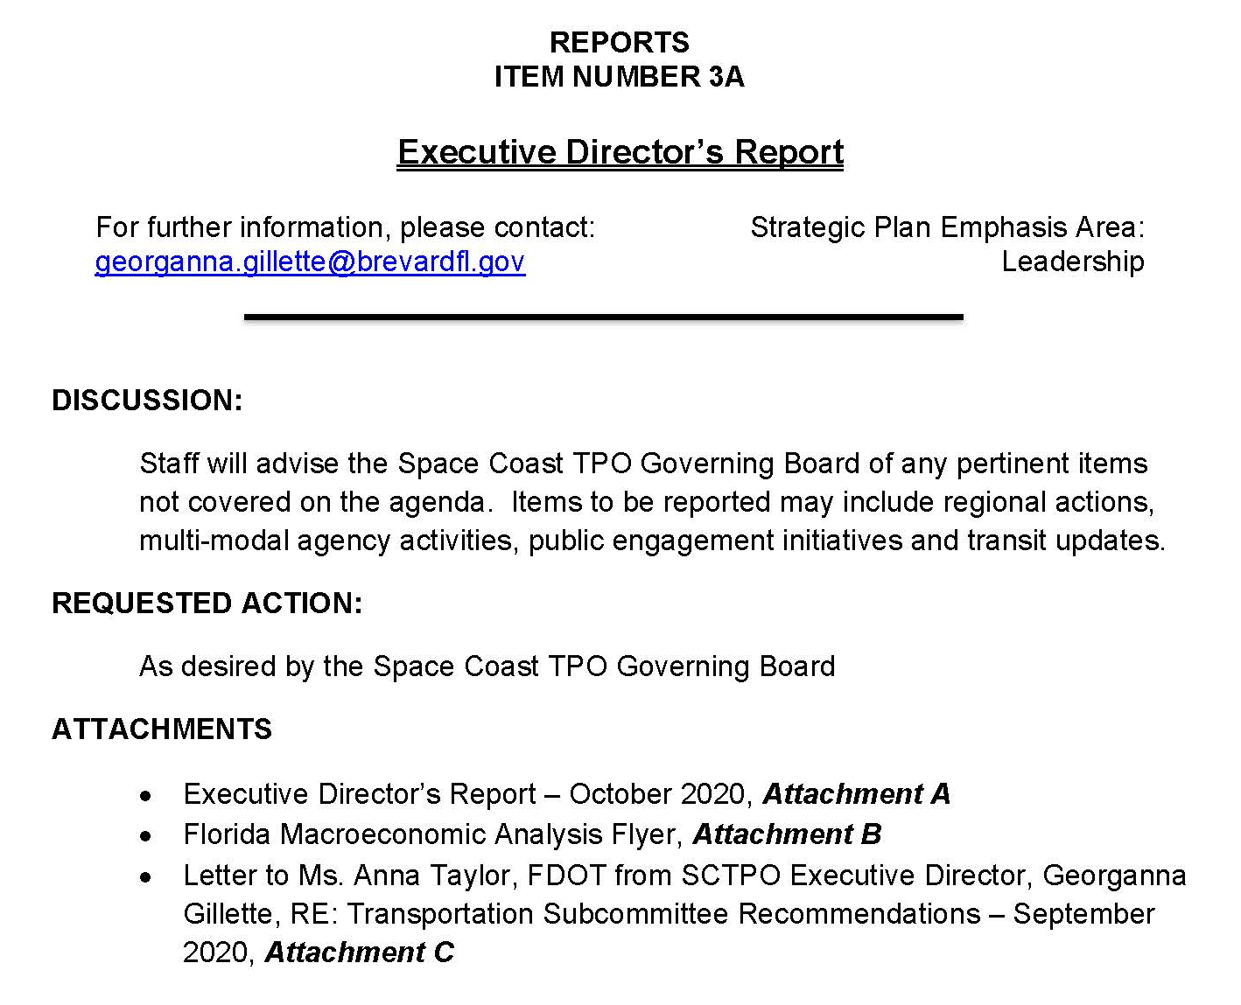
Agenda Format: Item Sheets
Staff contact for more information/questions
Supports Strategic Plan
What you are being asked to do
Supporting
Materials

Slide 42
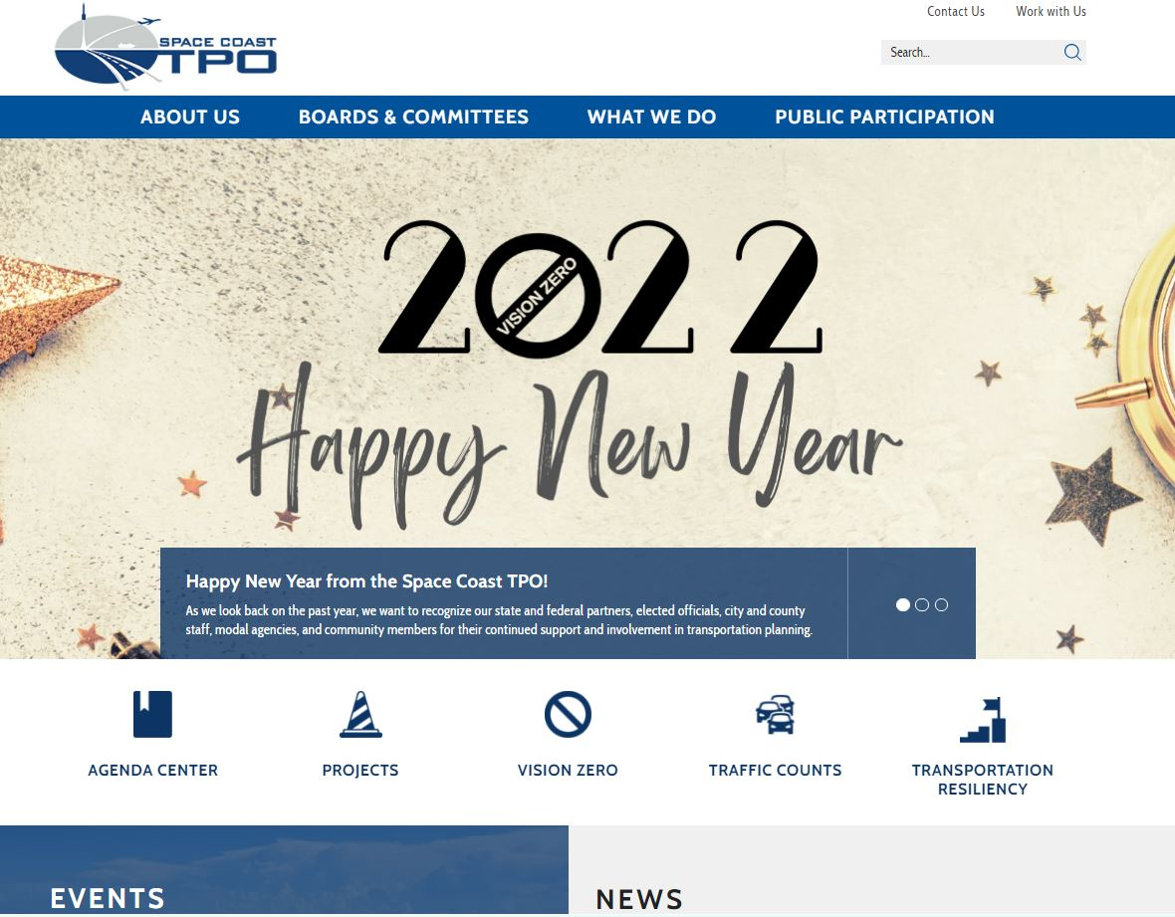
Agenda Distribution & Resources
Agendas are distributed via email and posted on the website
Committee and board agendas are available in the AGENDA CENTER on our website
Visit www.spacecoasttpo.com, and click on AGENDA CENTER to review current agendas, minutes, and meeting videos

Slide 43

Get Involved
Be an advocate and help educate our citizens
Promote SCTPO using social media
Volunteer to attend special events

Slide 44

Questions?
Notes:
Transportation policymaking requires foresight, analysis, and a commitment to see ideas bear fruit over the course of several years. For this reason, you do not serve on program or project organizations, but Transportation Planning Organizations. It is your authority and obligation to plan that we next will turn.

Slide 45
