Slide 1
Building Partnerships | Getting Your Partnerships Right on Track
Wednesday, April 13, 2023

Slide 2
Welcome
Notes:
Georganna (5 min)

Slide 3
Regional Intermodal Connections Committee
PURPOSE
To collaborate and make recommendations on modal choices and passenger rail initiatives.
MISSION
To build a passenger rail station and identify intermodal connections within Brevard County.

Slide 4
Goals
Generate passenger rail connection discussion, support, and partnerships
Work to create connections to final destinations
Understand intermodal grants and funding sources available
Make informed recommendations to the SCTPO board

Slide 5
Prior Meetings Recap

Slide 6
Meeting #1 – Set the Foundation

Slide 7
Meeting #1 – Identified Key Destinations

Slide 8
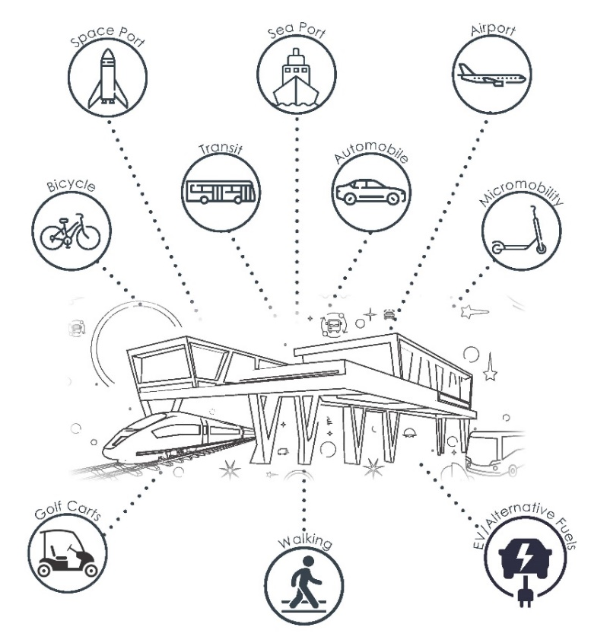
Meeting #2
Space Coast’s Transportation System of Tomorrow
Connected
Futuristic
Multimodal

Slide 9
How do we develop future transportation system?

Slide 10
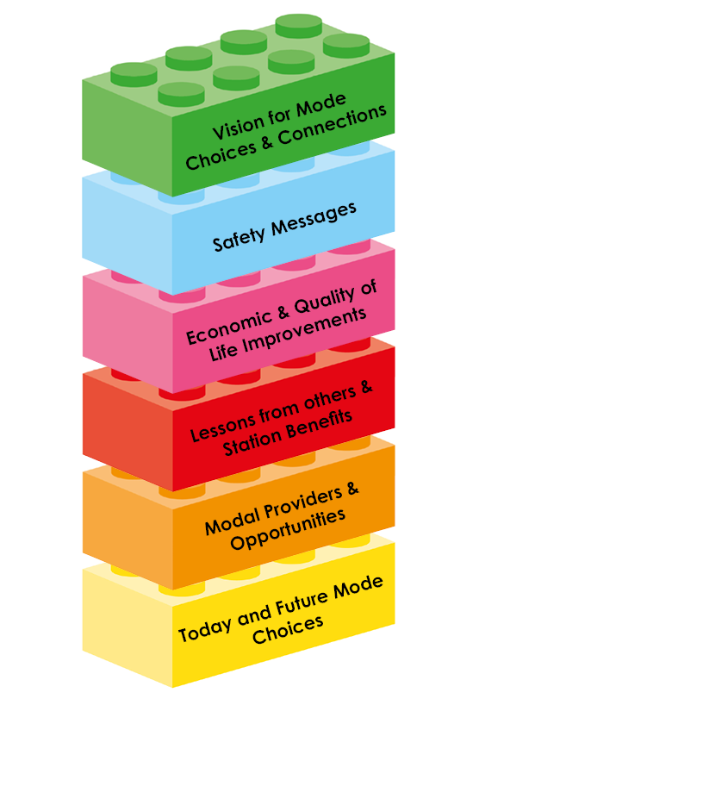
Building a Vision
Meeting 6-Vision
Meeting 5-Safety of Mode Choices
Meeting 4-Local & Regional Impacts
Meeting 3-Build Connections – How have others done it?
Meeting 2-Where are our modes?
Meeting 1-Setting the foundation
Notes:
Approval from SCTPO Board for projects related to intermodal and passenger rail
Obtain funding for intermodal projects through partnerships
Better understand benefits and need of passenger rail
Identify need for modal support including micro-mobility, transit, and non-auto modes

Slide 11
Today – Meeting #3
City of Cocoa’s Vision
Benefits
Transit Oriented Development

Slide 12
City of Cocoa
Samantha Senger

Slide 13
Economic Benefits of Intermodal Stations
Nick Lepp, HDR

Slide 14
Brightline Construction Update

Slide 15
Transit Oriented Development, Anticipating Rail in Your Community
Kim Delaney, Treasure Coast RPC

Slide 16
FDOT Intermodal Grant
Intermodal Passenger Rail Station Feasibility Study

Slide 17
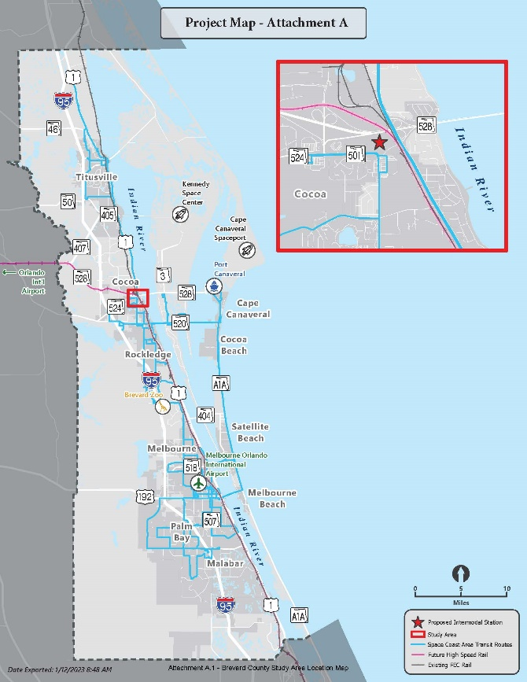
Intermodal Passenger Rail Station Feasibility Study
Space Coast TPO Awarded FDOT Intermodal Grant
$329,510
Analysis includes looking at:
Land Use and Transportation, Environmental, Catchment Area and Economic Benefits
Framework on how to implement
Identify ‘stages of success’
Guided by stakeholder committee with public engagement
Starts July 2023 – Complete February 2025

Slide 18
Next Steps

Slide 19
Next Steps
Next Committee Meeting: Think Regionally, Act Locally/Passengers on the Train
Wednesday, May 17, 2023 | 1:30 pm - 3:30 pm
Brevard Zoo (Nyami Nyami Lodge)| 8225 N Wickham Rd, Melbourne, FL 32940
More to come…
Transportation Funding & Safety | Punching our Ticket
Shared Vision | All Aboard

Slide 20
Thank you!

