Slide 1
OPERATIONAL RESILIENCY
Sheryl Bradley,
FDOT D5 Consultant
AECOM

Slide 2
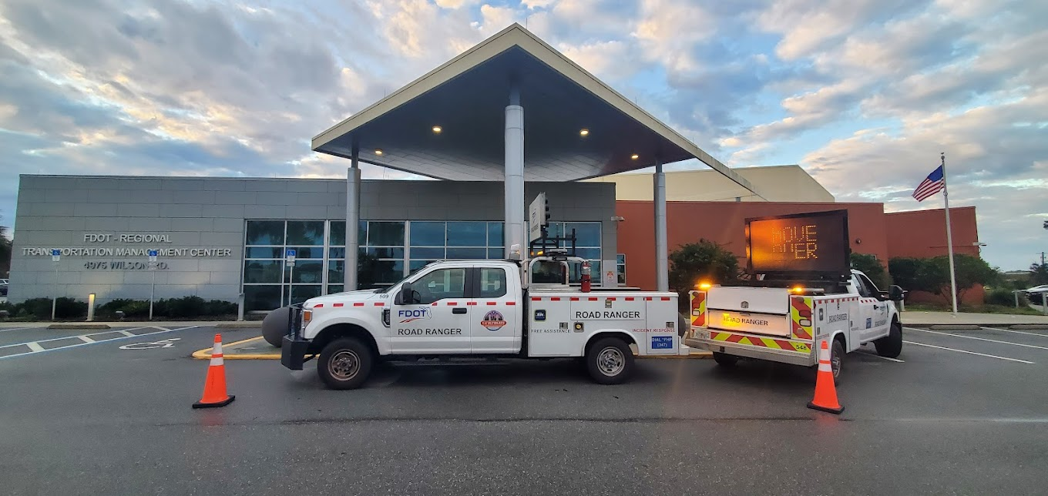
FDOT District 5 RTMC
Notes:
FDOT’s RTMC is in Sanford, FL
44,000 sq ft facility that serves as the communication hub for FDOT
Co-located with FHP Troop D dispatch and Fish & Wildlife Dispatch
Coordinates with 4 FHP troops, emergency response and traffic engineering departments from 9-counties and numerous cities

Slide 3
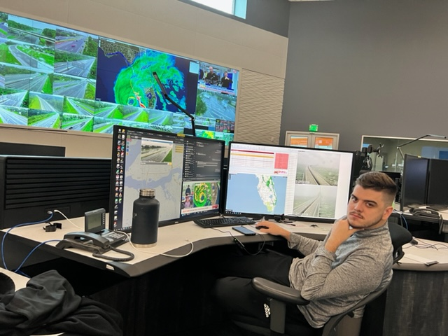
Emergency Operations
Monitoring weather & roadway conditions
Gathering data (speeds/volumes)
Communications (stakeholders and roadway users)
Coordination (incident response)
Notes:
Gathering data – are we significant increases in volumes which are resulting in decreased speeds and congestion? Indication of how many people are evacuating and allows for decision making about the need for additional capacity with implementation of Emergency Shoulder use
Keeping our stakeholders informed
Letting responders know where we are in the decision-making process and of any major concerns that may impact their ability to respond safety and efficiently
Coordinating incident response
Ensuring we have sufficient resources on the road or on standby to step in and assist where needed to ensure safe, quick clearance of all lane blocking incidents

Slide 4
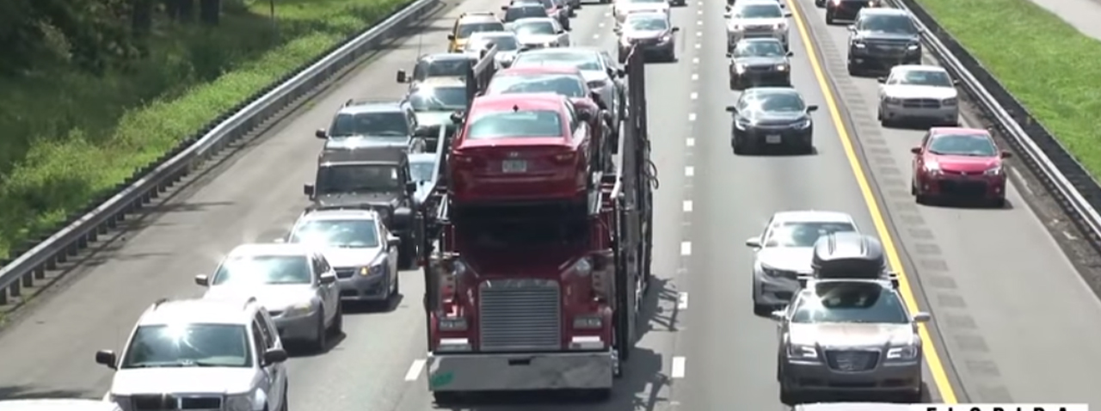
Emergency Shoulder Use (ESU)
Notes:
Previously mentioned Emergency Shoulder Use or ESU…
You may hear more about that from other speakers, but a high level summary is a temporary increase in interstate capacity, facilitated by opening a shoulder (typically the left shoulder) to the motoring public.
We leave the opposite shoulder (typically the right) available for emergency response
A lot of preparation and coordination goes into this effort from monitoring and facilitating quick clearance of any incidents, to ensuring shoulders are swept, and ensuring traffic control devices, signs, and law enforcement officers are in place to facilitate safe transition to and from ESU traffic pattersn.
Replaced contraflow plans, allowing us to keep southbound lanes open for response and recovery resources – huge part of our resiliency efforts with an emphasis on strategically staged resources that provide quick response and accelerated recovery
No better example than the remarkable recovery efforts demonstrated by FDOT and their partners in last year’s storm

Slide 5
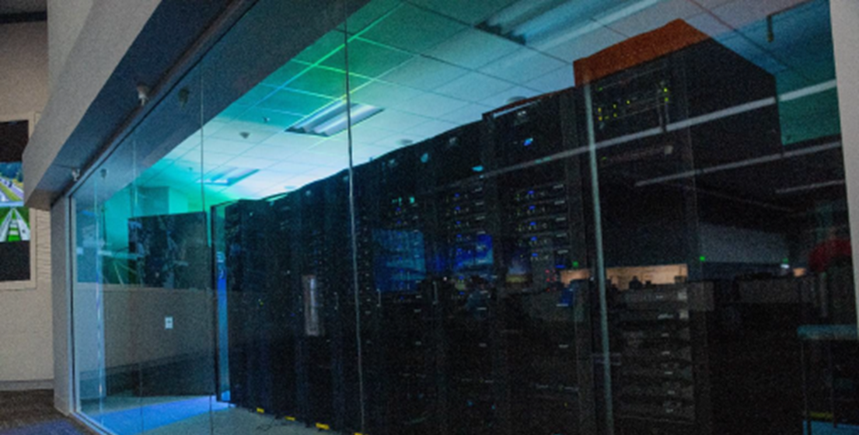
Resiliency in Operations
Facility
Rated for 150-mph winds
2 large diesel generators
Battery back-up for computers/servers
Redundancies
Personnel
24-hr staffing
RTMC staff
Road Rangers
Notes:
We are a 24-hr operation and require a facility that will withstand hurricane conditions, providing safe shelter for those who will be in place at the RTMC during the event
Alternate power supplies – prioritization of what gets emergency power and what doesn’t, to preserve resources
Redundancies in power, network and other resources – even down to laptops and hotspots
Back-up facility in Deland
While we always have a 24-hr staffing plan, that plan shifts when we consider that some personnel may not be able to make it in for several days and some will remain on site until they can be relieved.
Different experience levels required with key personnel needing to alter shifts to remain on site to manage the event
Road Ranger hours are typically extended to 24-hours for 2-3 days before the storm
Requires added manpower – plans in place with our vendor to bring in additional personnel from other districts or even other states if needed
We need to ensure they are closely monitored and pulled from the road when it becomes unsafe for them to be out
And we have to ensure adequate provisions – supplies such as water, oil, fuel
One of the reasons the Emergency Shoulder Use (ESU) plans are so important so we can keep supplies and personnel coming into the state for response and recovery efforts

Slide 6
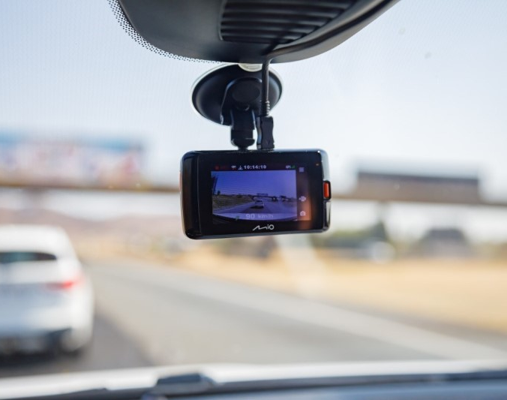
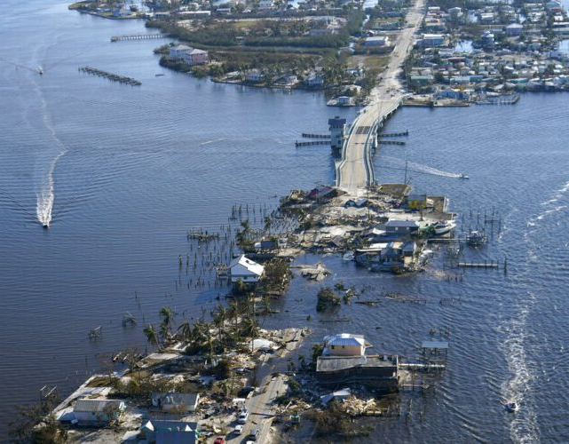
Resiliency in Operations
Devices
Cameras
Dash cameras
Trailer mounted
Drones
Radios
Processes
Change in staffing levels
Emergency Management functions
Additional reporting requirements
Notes:
We rely very heavily on ITS devices such as traffic cameras and speed and volume detectors to keep us apprised of what’s going on out on the roadway. With major storms, we can lose power to our devices and/or network connections. We have added some devices to our toolbox to serve as a back-up.
Front and rear facing cameras on Road Ranger trucks, so even if my regular traffic cameras are down, I can turn on and view cameras of our Road Rangers as they travel the roadways to see what traffic conditions are like or to get incident details. We also have portable trailers power and cellular capabilities for temporary camera deployment so we can continually monitor conditions at a particular site. We used this extensively SR 46 flooding between Brevard and Seminole County.
Drones played a huge part in expedited assessment and monitoring capabilities in difficult to reach locations. Drones were used extensively on the west coast….the Pine Island bridge shown here, as well as in Volusia/Flagler where A1A was impacted by significant erosion.
All of these video feeds can be brought back into the RTMC as well as the District EOC and Central Office in Tallahassee so that leadership remains informed of rapidly evolving conditions.
Even with radio communications for our Road Rangers, we have FHP radios as a back-up, but we have moved to a cellular radio system for primary communications that is not tied to any one network and will work off any cellular service. We have established relationships with cellular partners to ensure we can have portable towers deployed quickly, if needed, to maintain contact with our responders.
Processes
My team members who generally work 8-hours a day, Monday thru Friday, may end up on a 12-hour overnight shift through the weekend.
My project manager hat comes off and I step into an entirely different role with emergency management and incident response responsibilities
And, while we maintain our typical reporting functions, those are amplified with an entirely different level of documentation for damage and hazards that are reported to various entities within FDOT and to our external stakeholders
All this to say we have to have resilient processes that ensure someone is there to fill my emergency management functions when I need a nap, and I may need to step in and fill the role of an RTMC operator so they can get a dinner break, so we do a lot of cross training and documentation to ensure we leave no gaps in personnel and processes.

Slide 7
Questions?
Sheryl Bradley
Project Manager
Sheryl.Bradley@aecom.com
Sheryl.Bradley@dot.state.fl.us
Phone: 321-257-7347

