Slide 1
Transportation Resiliency Master Plan
Ride the wave to resiliency community Symposium
March 1, 2023
Notes:
Sarah

Slide 2
Transportation resiliency master plan (RMP)
Transportation Resiliency is the ability of the transportation system to recover and regain functionality after a major disruption or disaster.
Source: visitspacecoast.com/
Notes:
Sarah’s last slide and will transition to Mary

Slide 3
The Transportation RMP answered:
What are the current conditions?
What puts people and infrastructure at risk?
What infrastructure is most important to protect?
What actions should we take to protect our critical and vulnerable infrastructure?

Slide 4
Shocks/Stressors
Storm Surge/Wind: Hurricane Category 3
Flooding: FEMA 100-Year Flood Inundation
Sea Level Rise: 2100 NOAA High Curve
Fire: Wildfire Hazard Potential and Smoke Buffers
Shoreline Erosion: 200’ from Indian River Lagoon, Banana River, and Atlantic Ocean

Slide 5
Who we Engaged
Board
Committees
Task Force
A Resilient Brevard
General
Public
Key
Stakeholders
Underserved Communities
Focus
Groups
5
Notes:
We engaged a diverse set of stakeholders throughout the Transportation RMP
They each played a role in helping shape the Transportation RMP
and in creating a resilient Brevard
Some play more of an advisory role, while others serve as sounding boards, and close the gap in data and intel about specific areas of Brevard, and others are partially responsible for the strategies that come out of the Transportation RMP

Slide 6
Key Transportation RMP Stakeholders
Notes:
Stakeholders may be Focus Group members or other federal/state/local agencies
NOAA’s National Centers for Coastal Ocean Science
National Park Service
USFWS
FHWA
UF/IFAS Extension/UF GeoPlan
County and local chambers of commerce
Economic Development Commission
Space Coast Area Transit
Space Coast Office of Tourism
NASA
Ports
Military Installations
Brevard County Emergency Operations Center (EOC)/Hurricane Evacuation
Brevard Sustainability Working Group
1000 Friends of Florida (Brevard 2070)
Indian River Lagoon Scenic Byway
Brevard County Waste Management

Slide 7
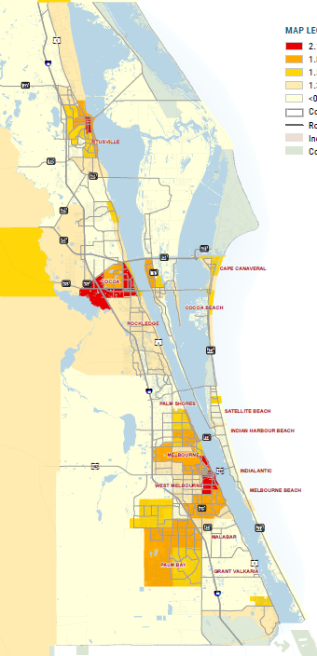
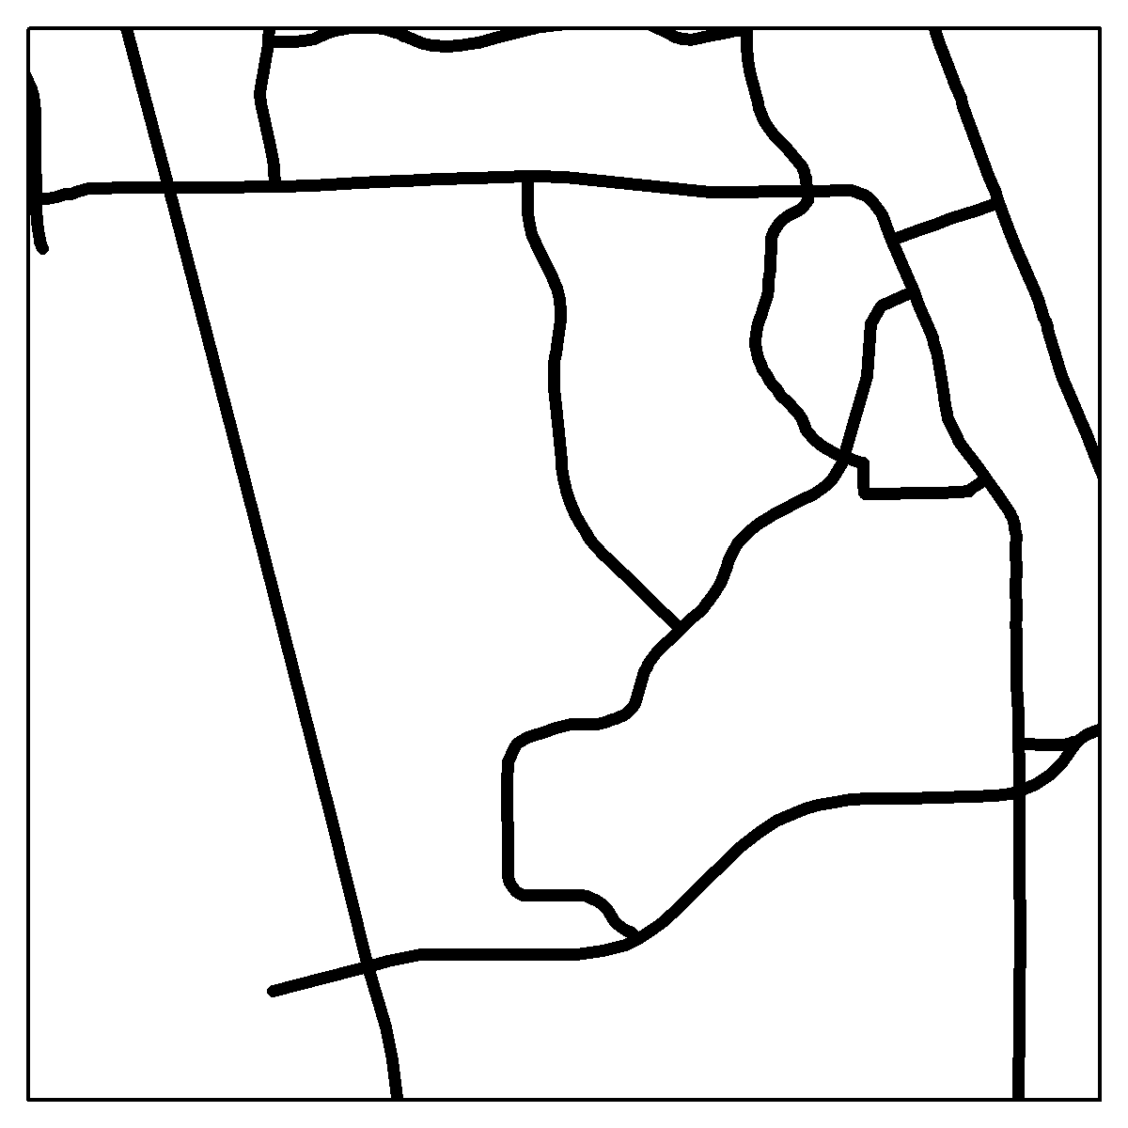
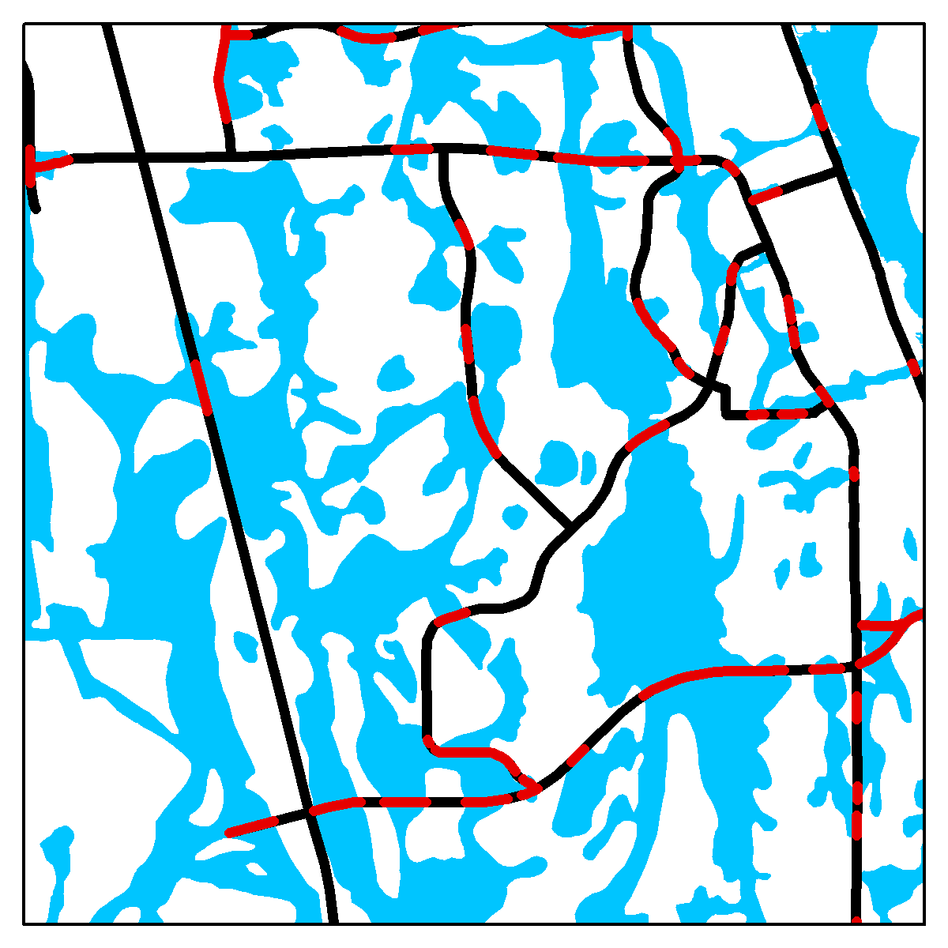
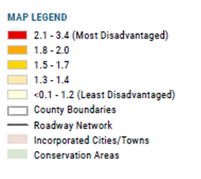
what we analyzed – Vulnerability
Impact Area of Shock/Stressor
Transportation Infrastructure
Vulnerable Transportation Infrastructure
IF Vulnerability Score > 0, consider if the corridor serves vulnerable populations
Notes:
As part of this, looked at underserved populations and included in analysis

Slide 8
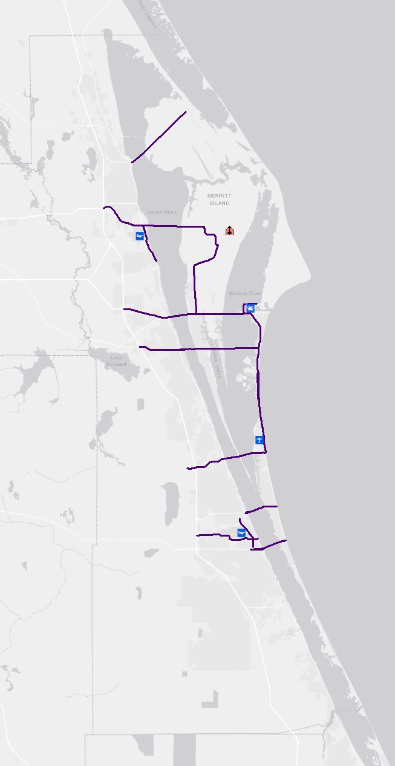
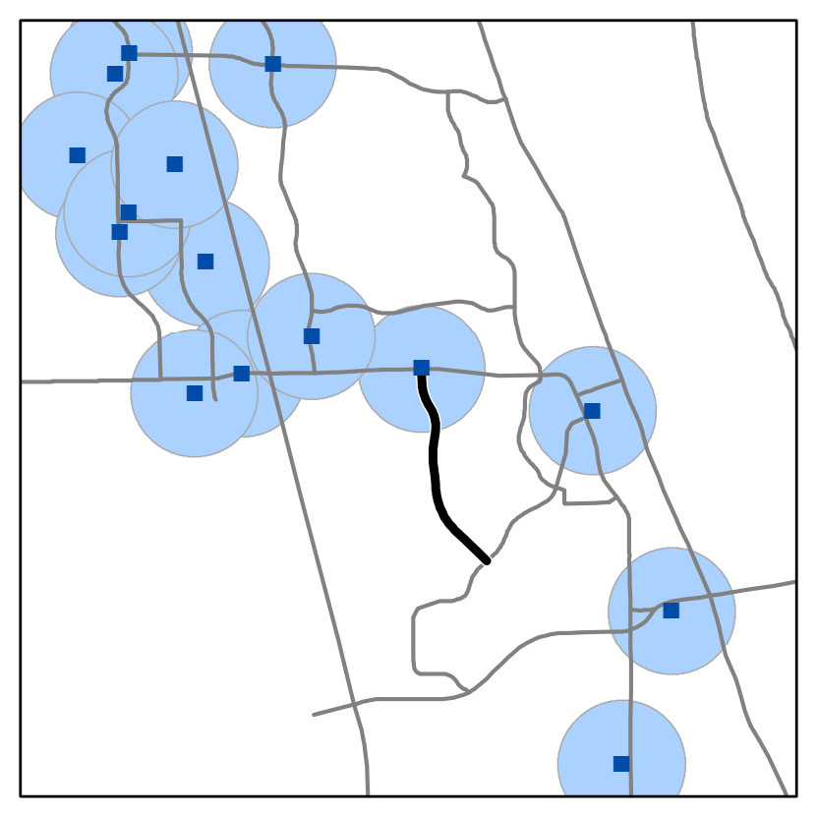
what we analyzed – Criticality
Critical Regional Assets
Port Canaveral
Patrick Space Force Base
Kennedy Space Center
Melbourne Orlando International Airport
Space Coast Regional Airport
Causeways
1 critical local asset is within 1/2 mile of the corridor

Slide 9
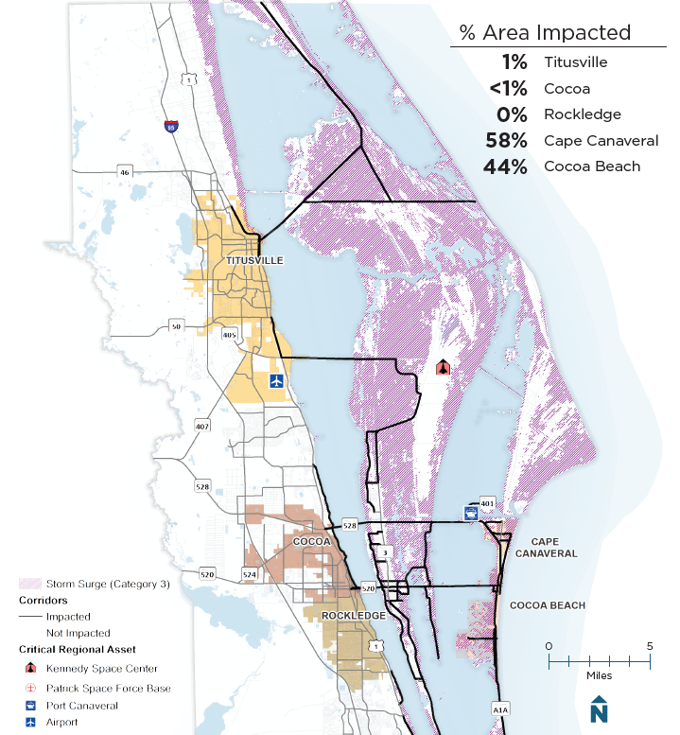
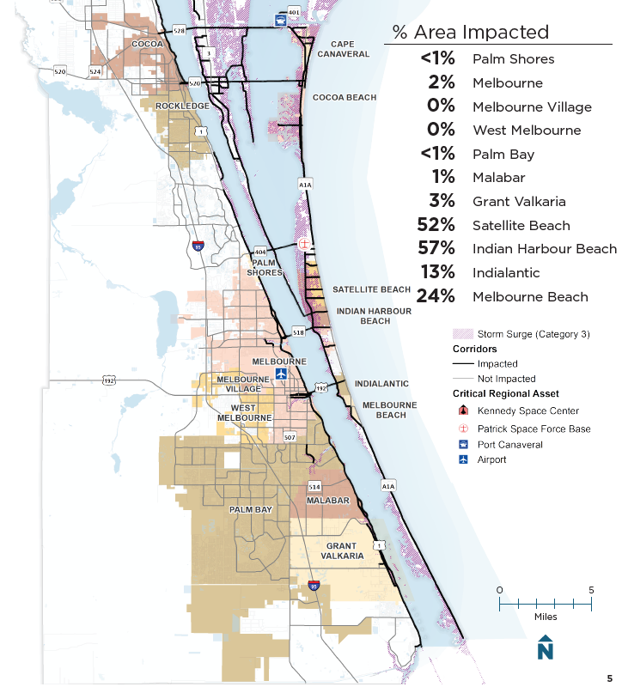
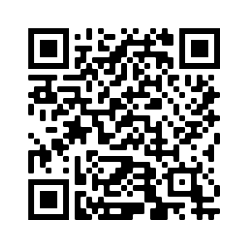
What we found – Storm Surge/Wind
27% (235 miles) of Roads in Brevard are Impacted
Scan here to review all five booklets:
Notes:
30 seconds each – redefine shock/stressor and impact area
QR code mention

Slide 10
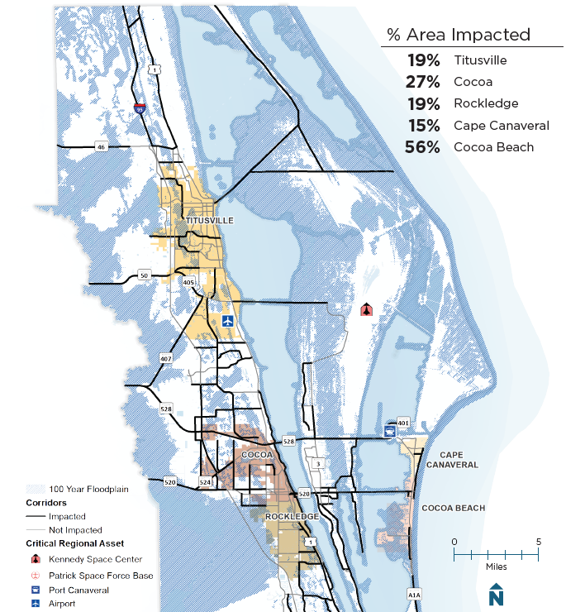
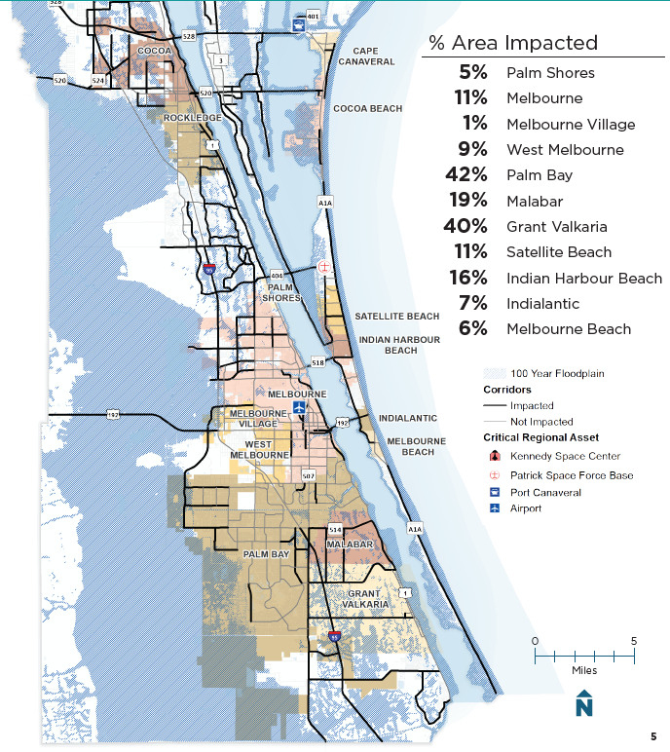
What we found – Flooding
56% (485 miles) of Roads in Brevard are Impacted
Scan here to review all five booklets:
Notes:
520 shut down one land in each direction
SR 46 was washed out

Slide 11
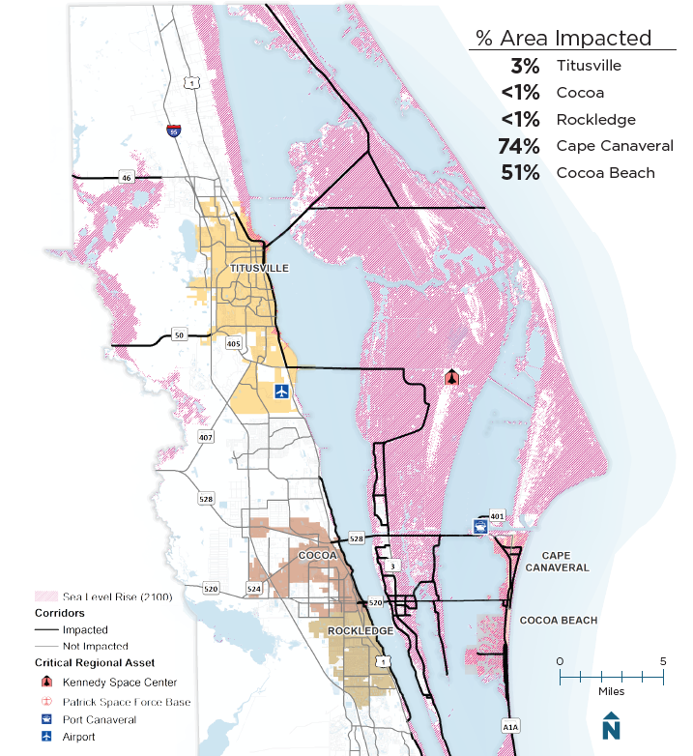
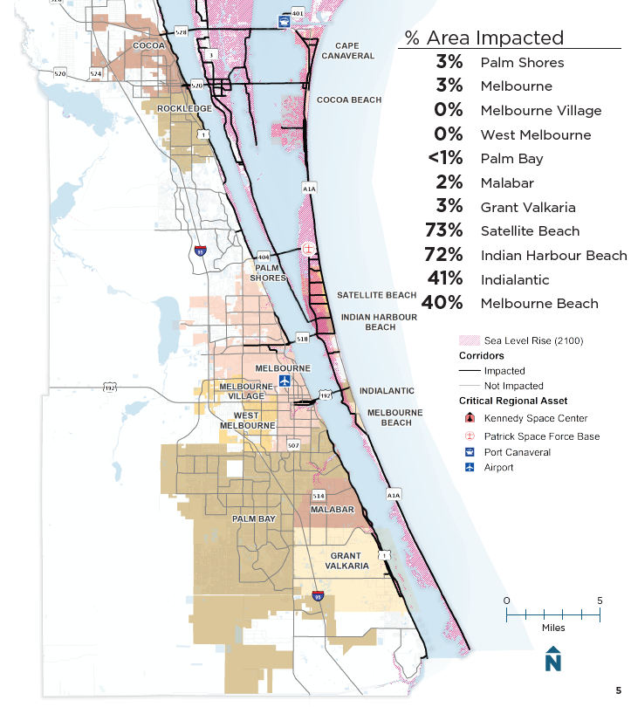
What we found – Sea Level Rise
29% (253 miles) of Roads in Brevard are Impacted
Scan here to review all five booklets:
Notes:
Climate change versus SLR
Just saying we’re seeing impact of seas rising, and not what caused it
Be prepared to discuss data source to Peter Fuskis

Slide 12
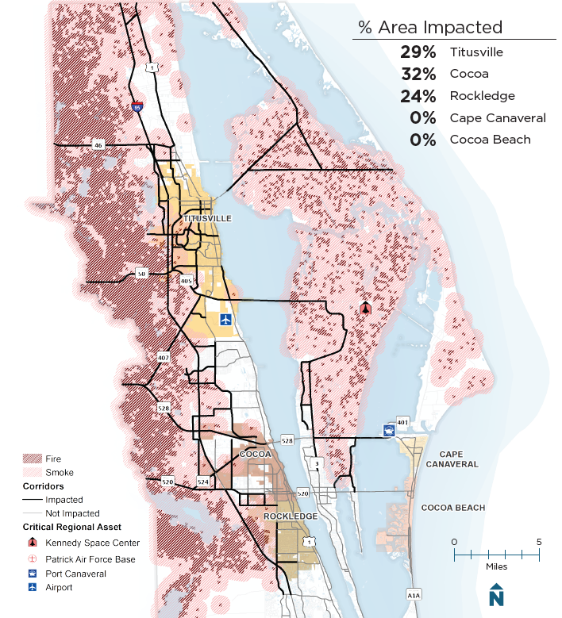
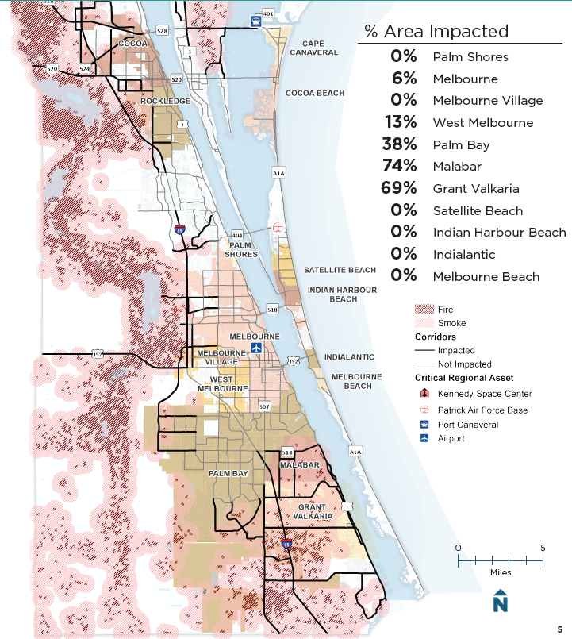
What we found – Fire
44% (377 miles) of Roads in Brevard are Impacted
Scan here to review all five booklets:

Slide 13
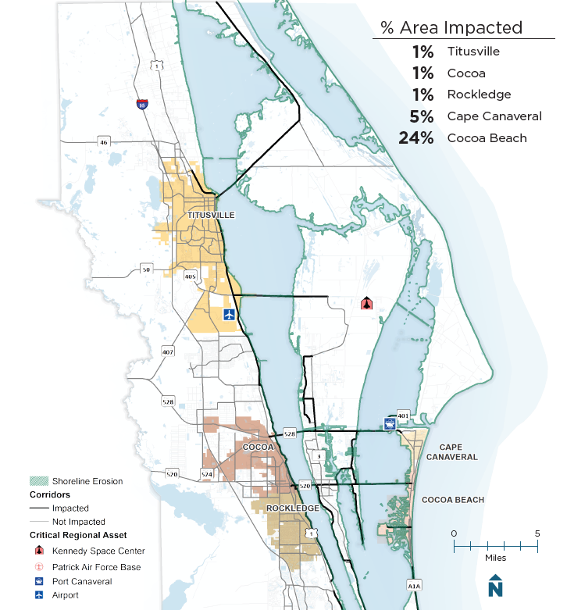
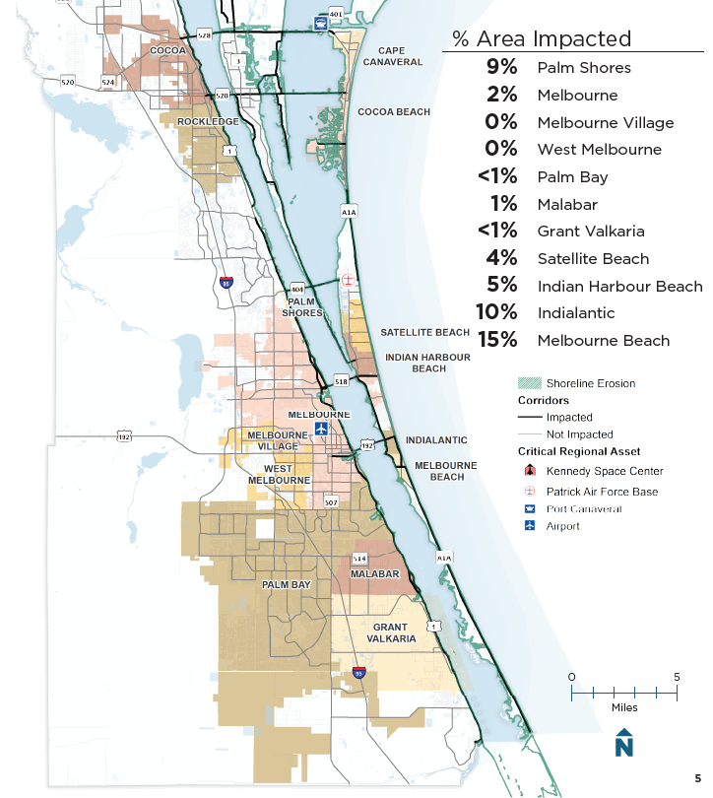
What we found – Shoreline Erosion
20% (176 miles) of Roads in Brevard are Impacted
Scan here to review all five booklets:
Notes:
We can share key points from all or a few of the shocks/stressors here

Slide 14
A resilient transportation system serves everyone
In Brevard County:
585,507
1 in 4
(137,000) residents are over the age of 65
people live in 230,417 households
1 in 3
(66,000) households include someone with a disability
Resiliency projects consider the needs of everyone
1 in 3
(175,000) residents live below or near the poverty line
1 in 20
(11,000) households do not have a car
Source: 2019 American Community Survey

Slide 15
Implementing resiliency
Opportunity for Resiliency Project
Vulnerable &
Critical Corridors
in Brevard
Planned Projects
In Brevard
Opportunity to Add Resiliency to Project

Slide 16
Implementing resiliency
What projects are planned?
What type of project is it?
How far are we into the project?
Sometimes resiliency elements can be added to planned projects
What corridors are vulnerable and critical?
How can resiliency be incorporated?
Implement the project with resiliency benefits
What funding is available to improve resiliency?
Other times resiliency projects may be implemented independently

Slide 17
Follow the money…
Over $XXX Available for Resiliency Projects
New Programs
Existing Programs – resiliency criteria
$Billions are Available for Resiliency Projects
New Federal and State Funding Sources
Resiliency Criteria for Existing Funding Sources
Planning, Design and Construction Phases are Eligible
Some Programs Do Not Require Matching Funds
Applicants can be States, Regions/TPO and Local Governments

Slide 18
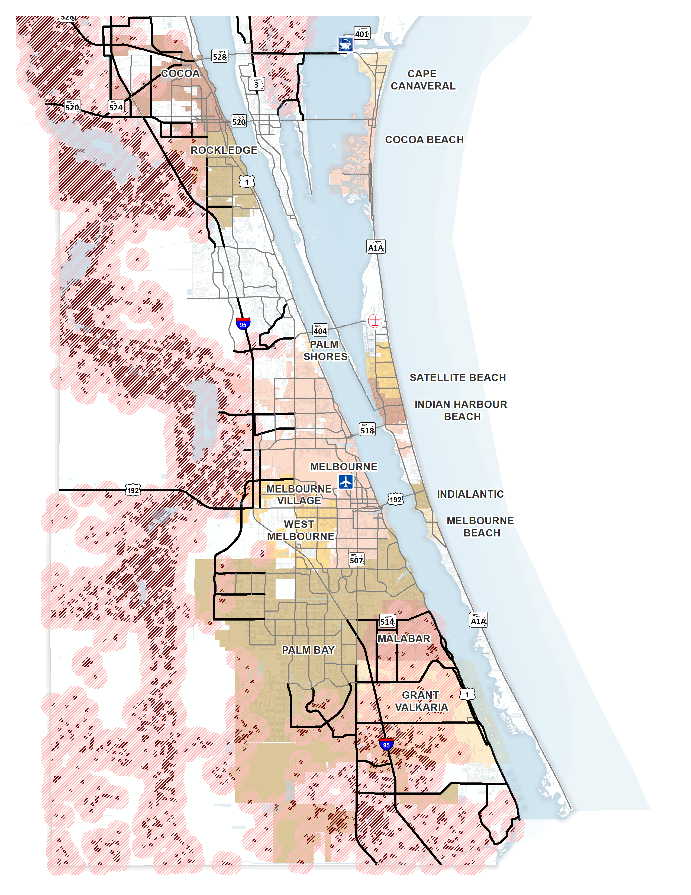
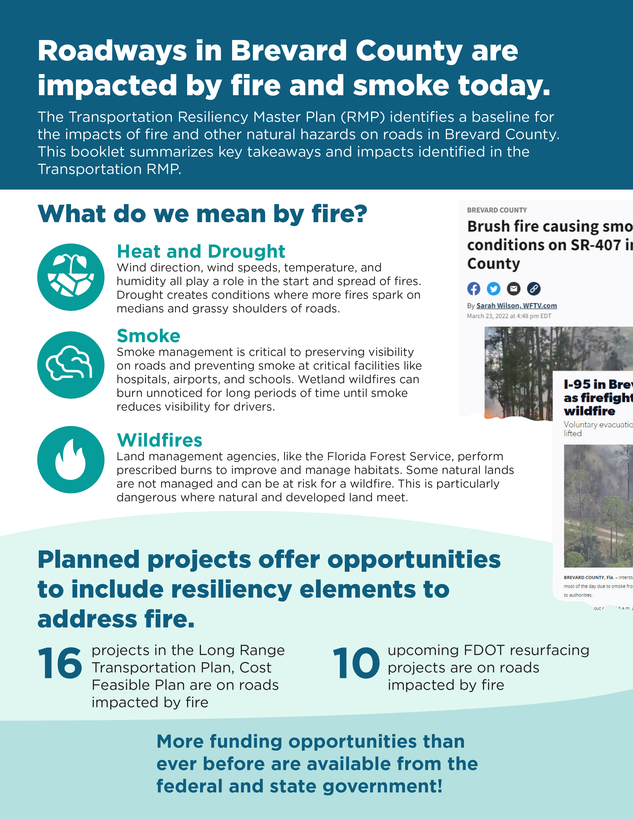
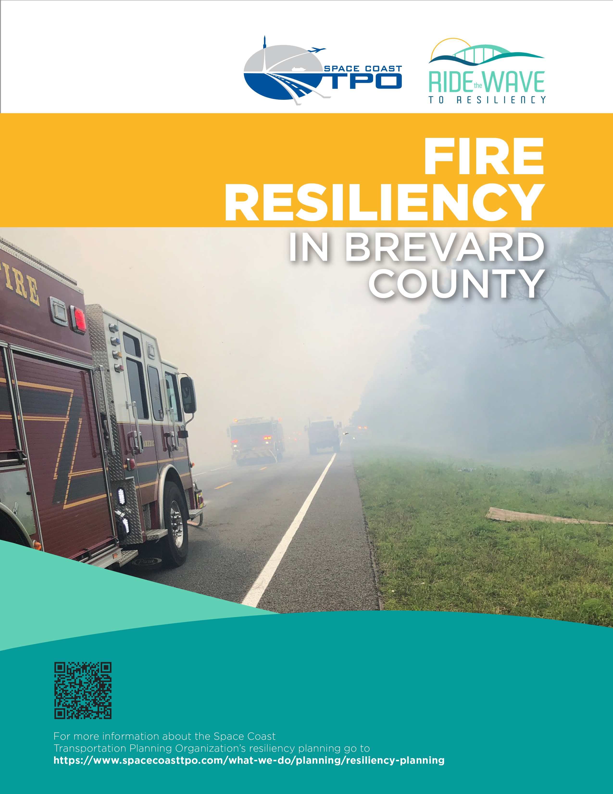
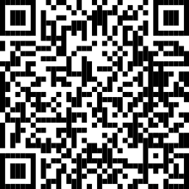
Resiliency resources
Data
Maps - https://arcg.is/0TvOq8
Booklets
Videos, Oh My!

Slide 19
Thank you!
Sarah Kraum, Senior Transportation Planner
(321) 350-9263
sarah.kraum@sctpo.com
http://spacecoasttpo.com
Mary Taylor Raulerson, Senior Principal Planner
(321)230-3860
mraulerson@kittelson.com
http://kittelson.com

