Slide 1
Port Canaveral Hurricane Preparedness and Response

Slide 2
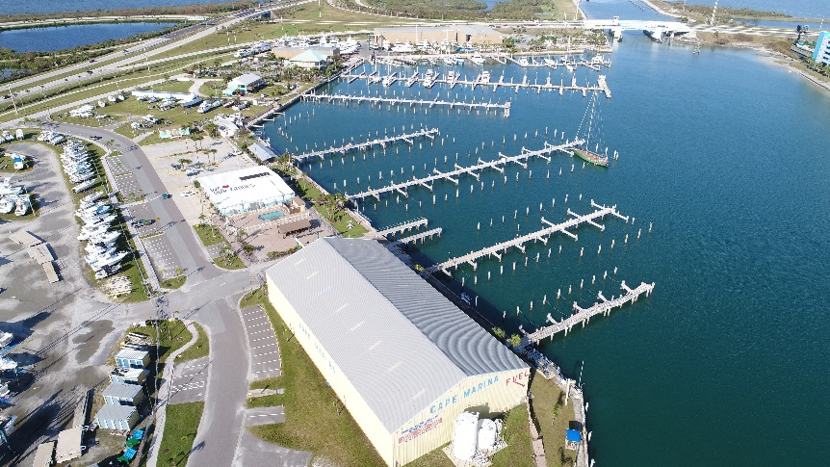
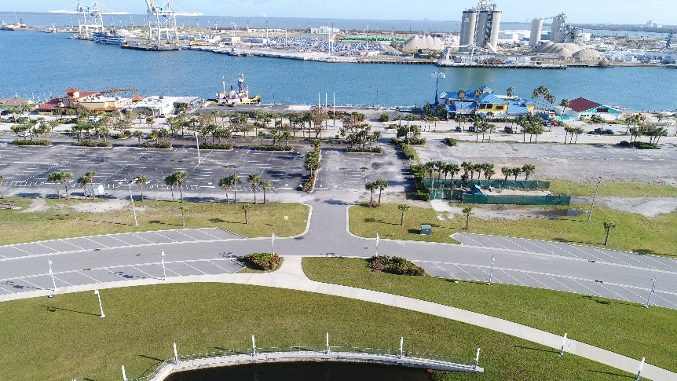
Planning and Mitigation
Update Heavy Weather Plans, Review After Action Reports, and complete Improvement Plans
Evaluate mitigation projects – leverage grant funding
Monthly hazard surveys of all port facilities – heavily focused during the season
Identify and secure staging locations – on and off-site
Survey vessel for damage assessment
Incident response equipment
Order equipment/supplies and stockpile consumables
Host annual Heavy Weather Meeting with USCG, CFR, BCSO, and NWS
Ensure commercial fishing and recreational vessels aware of evacuation requirements

Slide 3
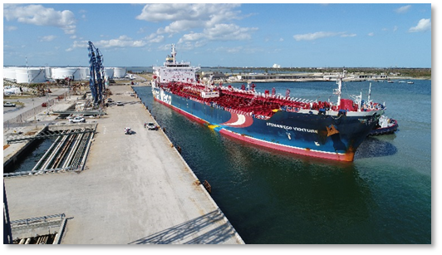
Objectives and Priorities
Preparation (Prior to Landfall)
Phased closure of Port Canaveral businesses – water and shoreside
Continuous fuel deliveries until no longer safe
Complete shutdown of all operations at Condition Zulu
“Ride Out Team” (Sheriff’s Dept. & Fire Rescue)
Phased return of storm damage assessment personnel
Resources mobilized to assist as needed (emergency contractors)
Response/Recovery (After Landfall)
Survey channel and aids to navigation
Damage assessment operations
Assess shoreside and waterside facilities
Receive fuel ships and restore truck deliveries to Central FL
Receive cruise ships for passenger operations
Resume operations as quickly as possible

Slide 4
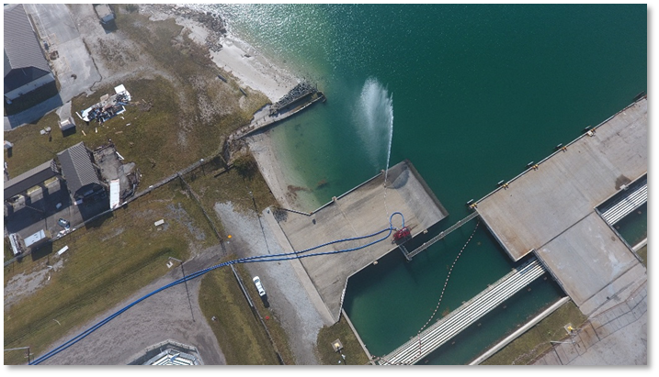
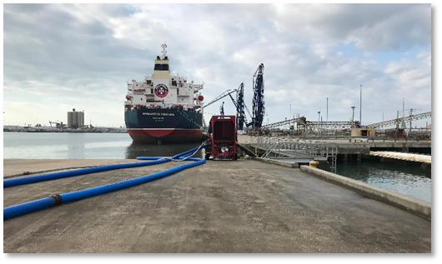
Past Challenges to Recovery
Catastrophic loss of water supply
Fire protection/sanitation compromise
Widespread and total power loss impacted core operations
Generating capacity available at cruise terminals
Fuel delivery required additional generating capacity
Intermittent, unreliable power restoration over several days
Sea state conditions post-storm

Slide 5
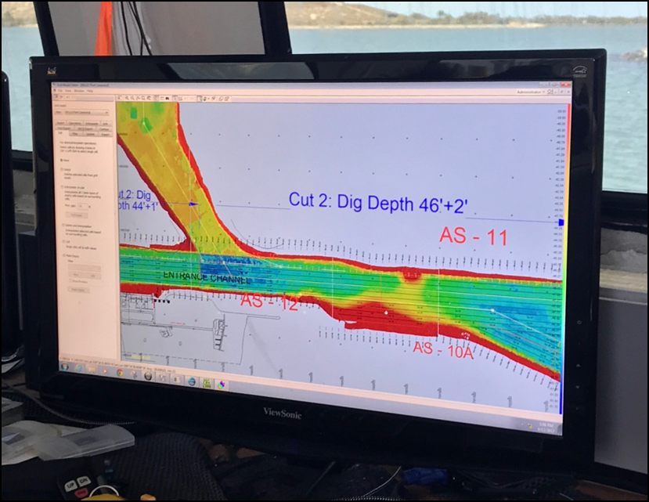
Response and Recovery Considerations
Channel survey immediately when safe
Restore water, power, sewer services ASAP
Coordination with EOC for restoration
Pre-established contracts for support/repairs
Local and Statewide mutual aid agreements
Identification of port partner resources and capabilities
Be proactive and not reactive!

Slide 6
Thank you

