Slide 1
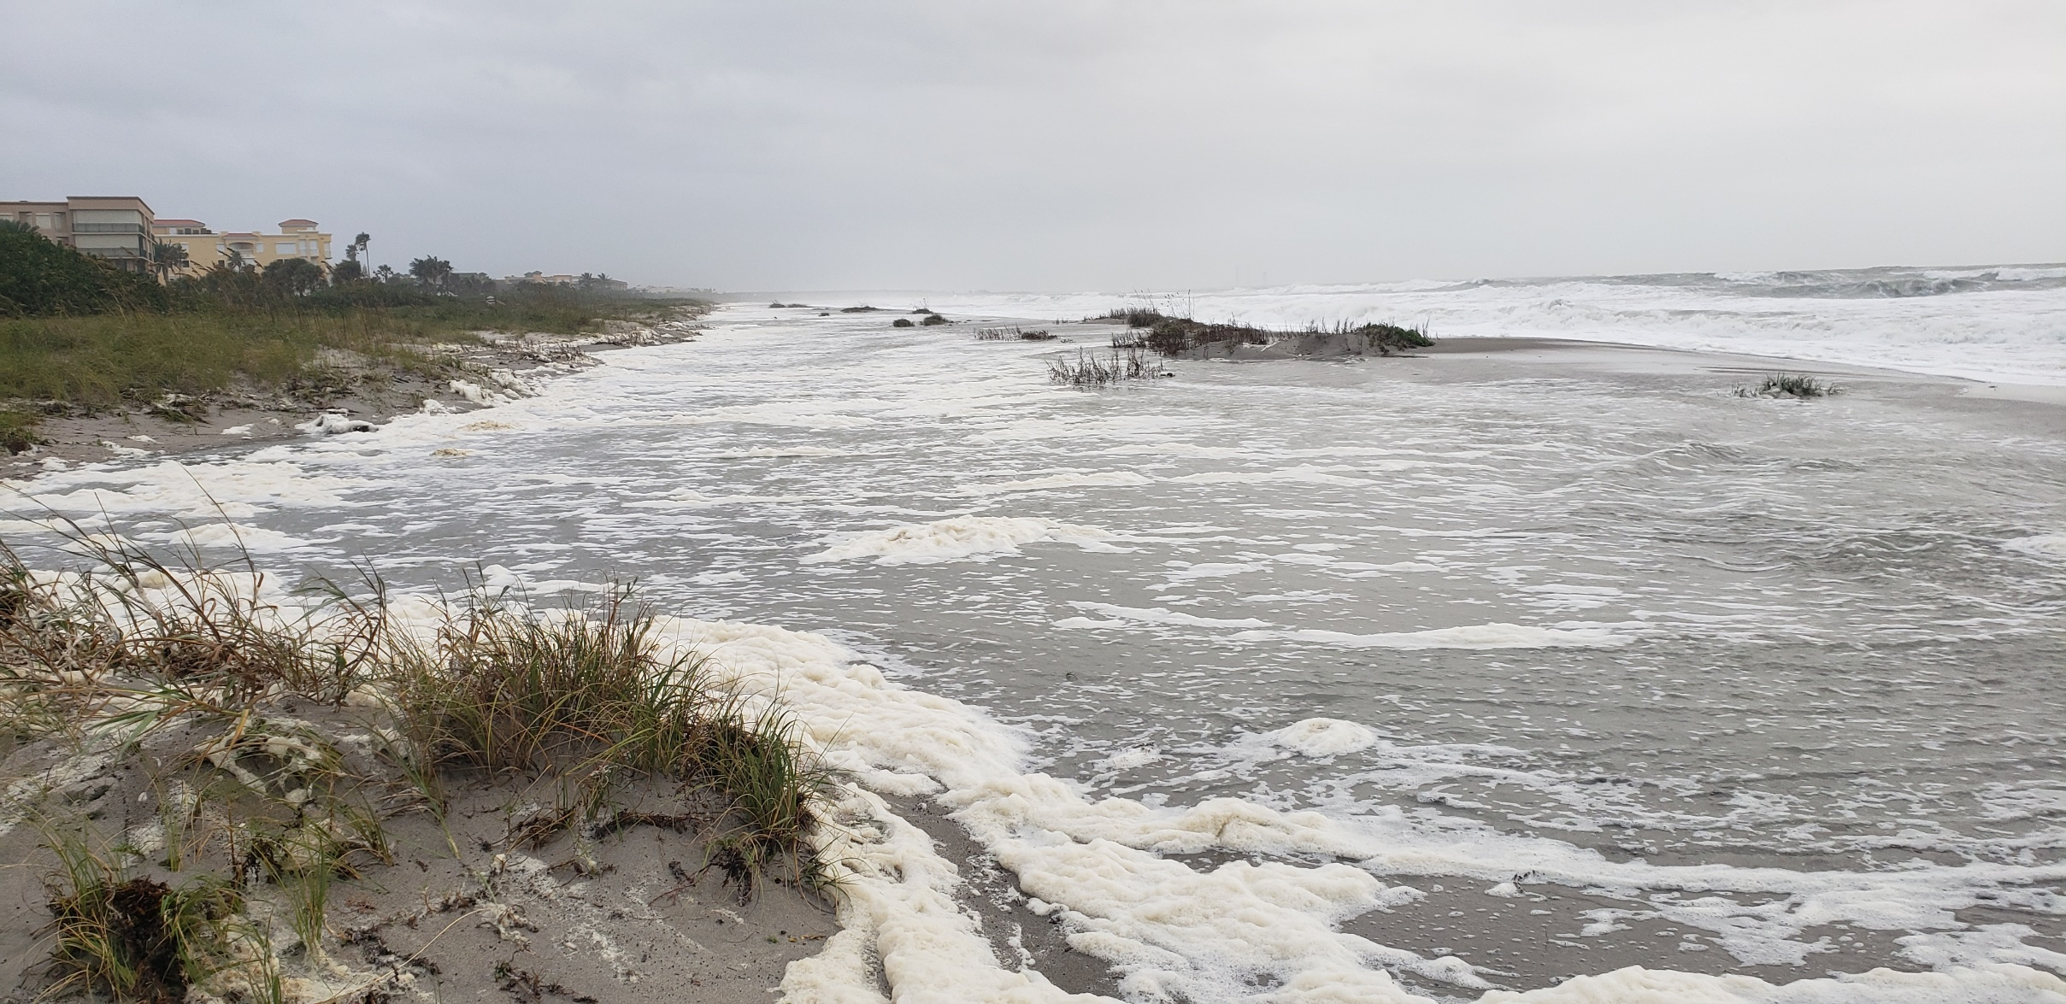
Tyler Ave. Public Beach Crossover: Hurricane Nicole storm surge.

Slide 2
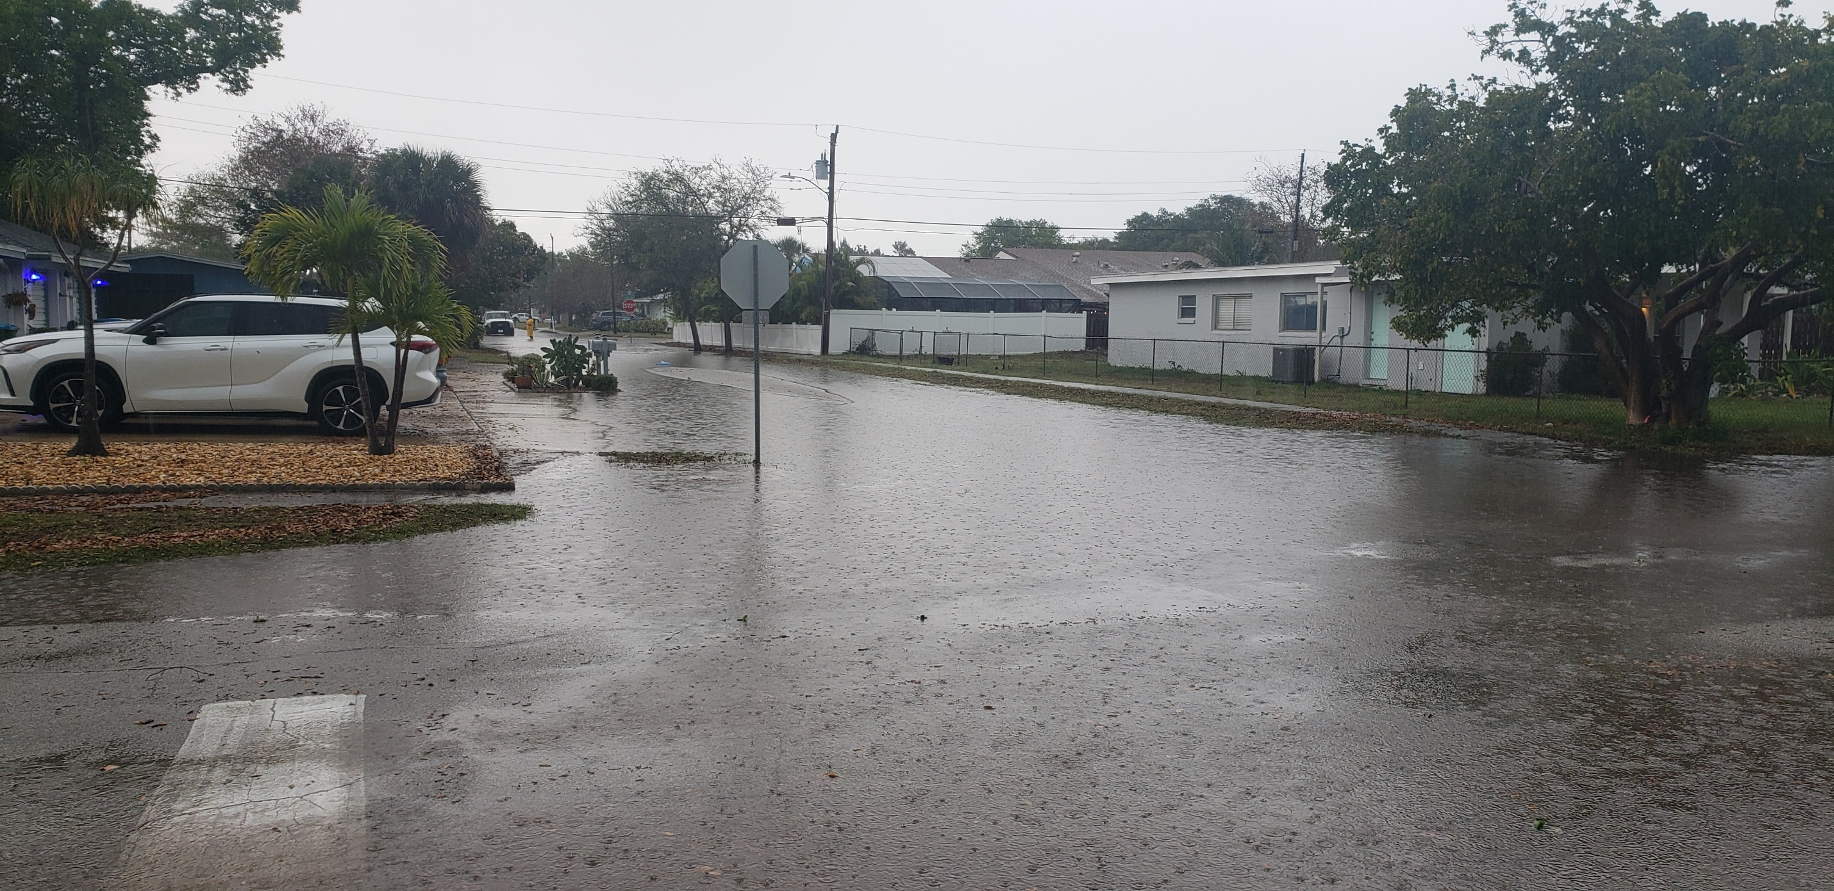
Polk Ave.: Urban street flooding via afternoon thunderstorm.

Slide 3
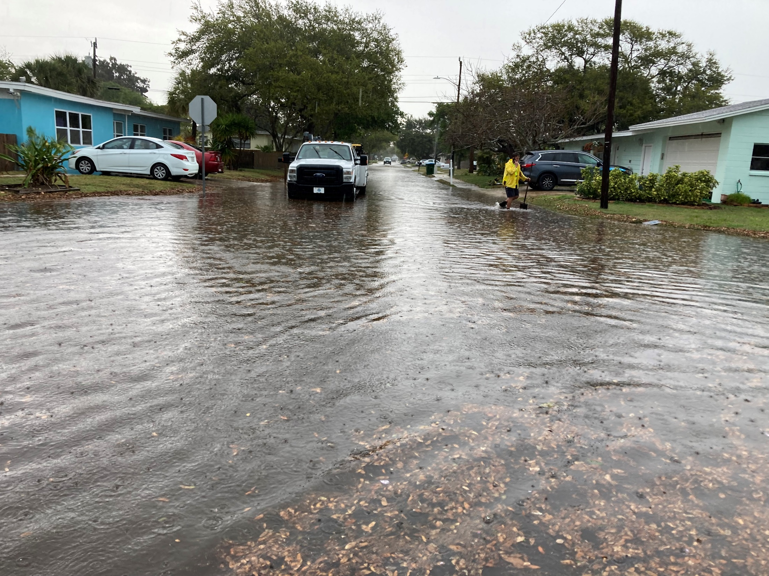
Tyler Ave.: Urban street flooding via afternoon thunderstorm.

Slide 4
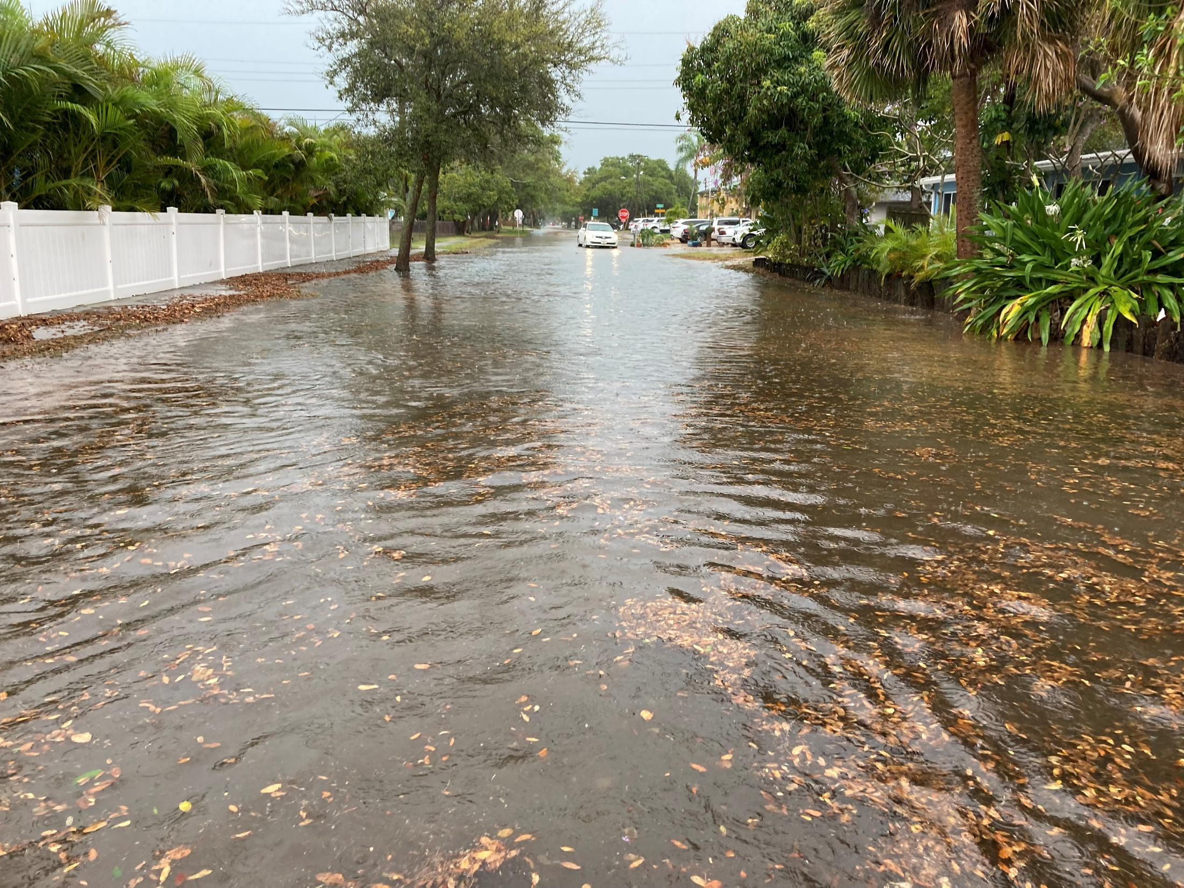
Tyler Ave.: Urban street flooding via afternoon thunderstorm.

Slide 5
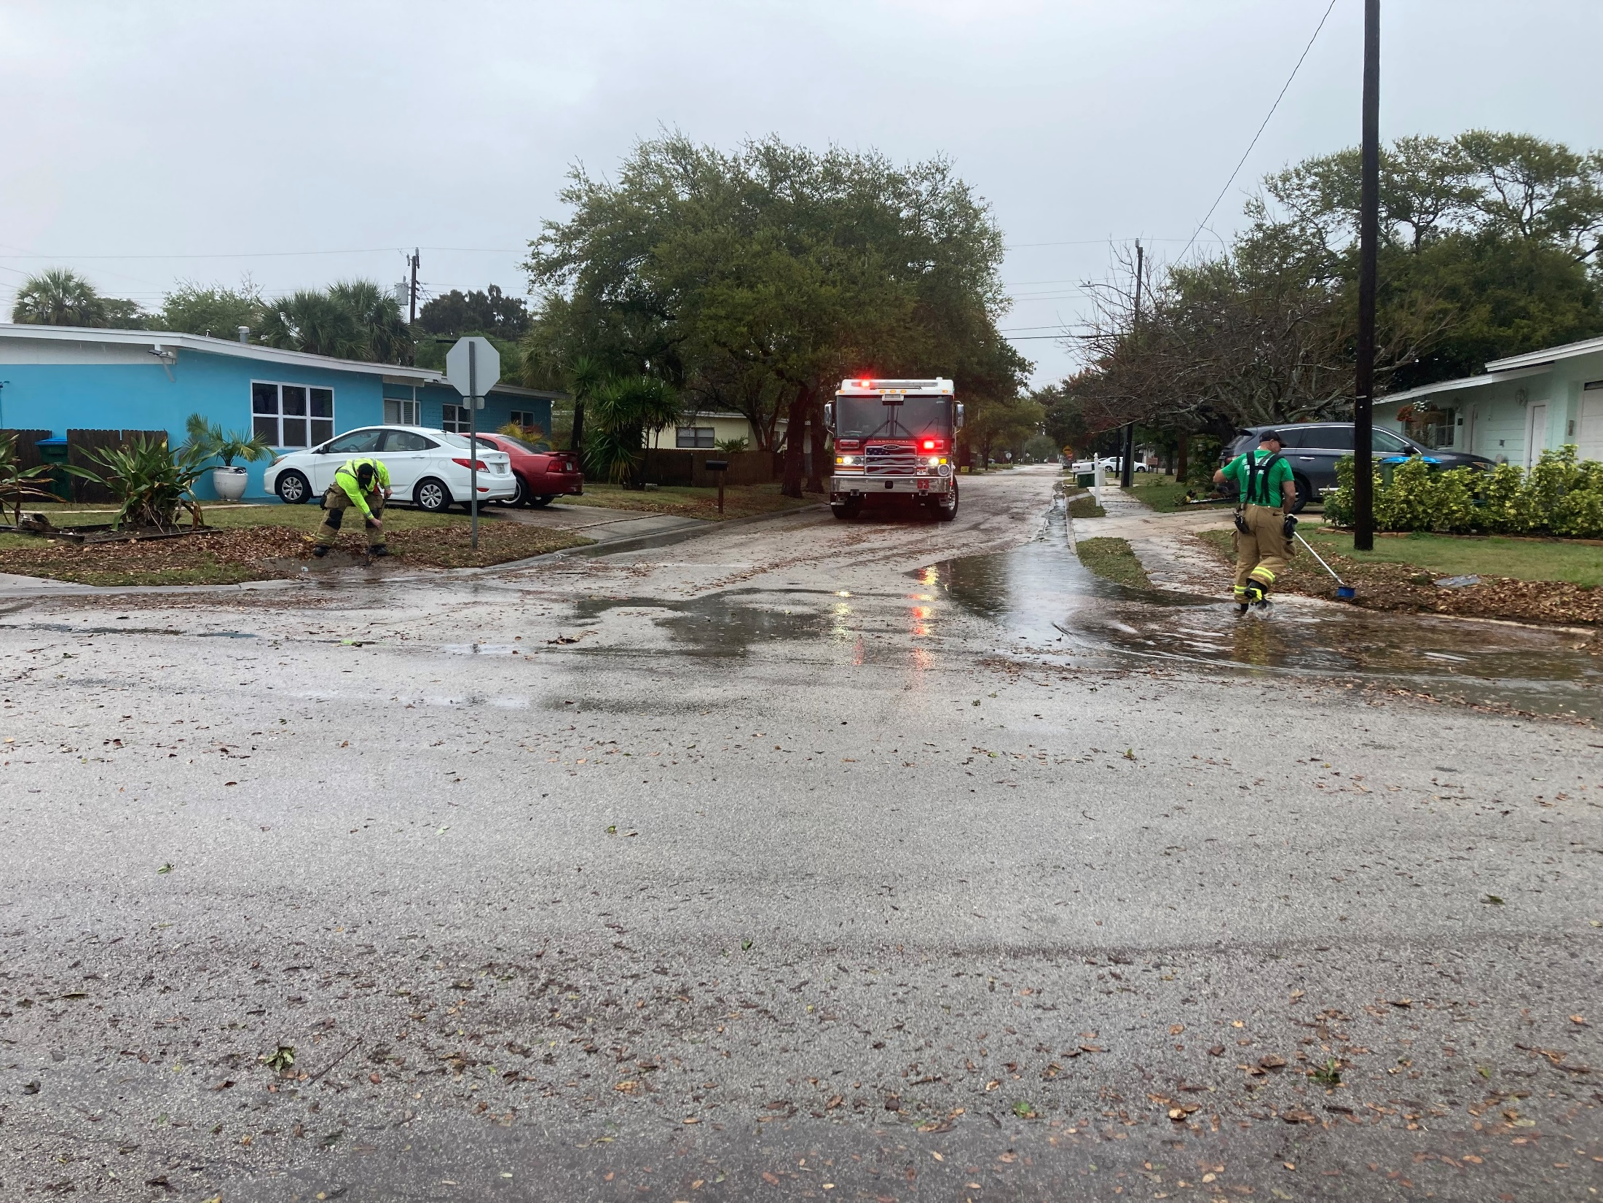
Tyler Ave.: Urban street flooding via afternoon thunderstorm.

Slide 6
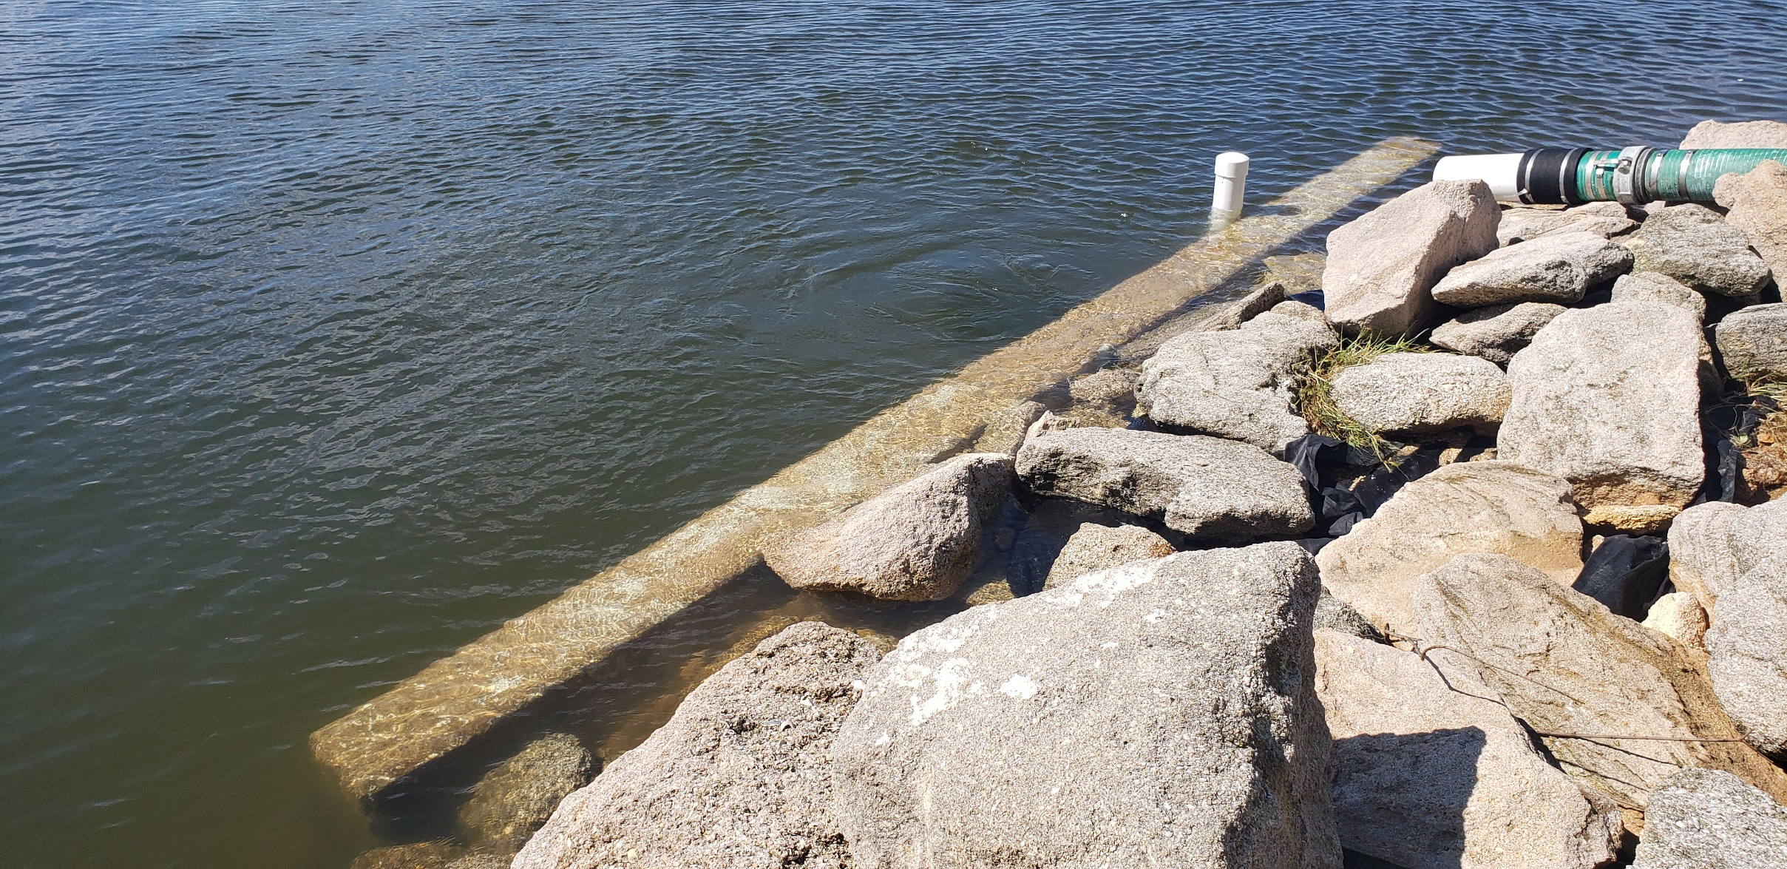
Center St. Stormwater Outfall: Hurricane Ian-related water rise within the Banana River Lagoon.

Slide 7
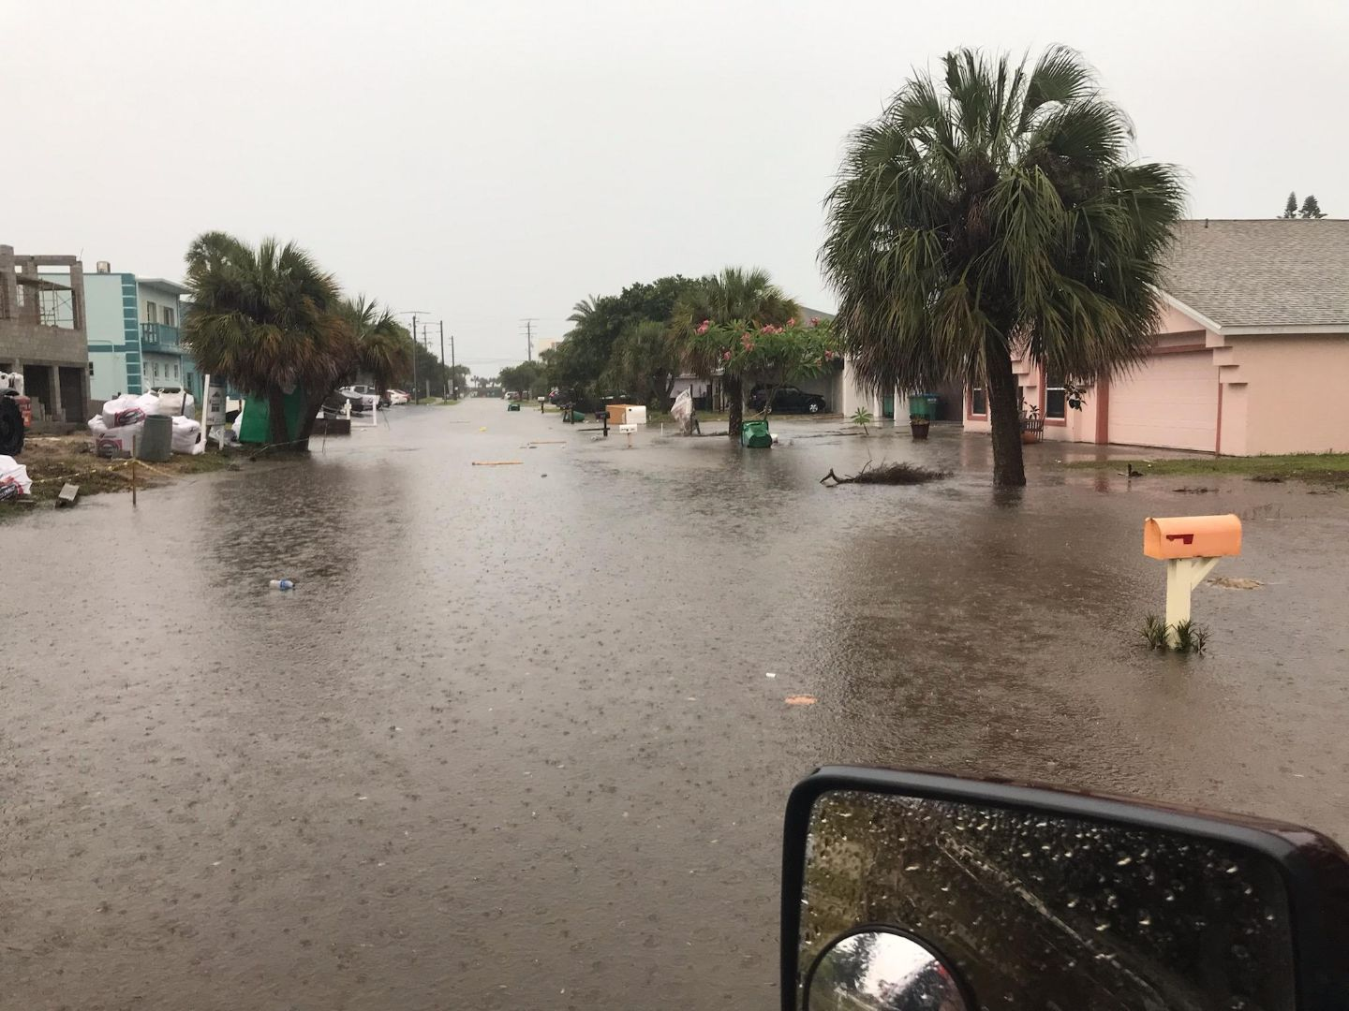
Fillmore Ave.: Severe urban street flooding via afternoon thunderstorm.

Slide 8
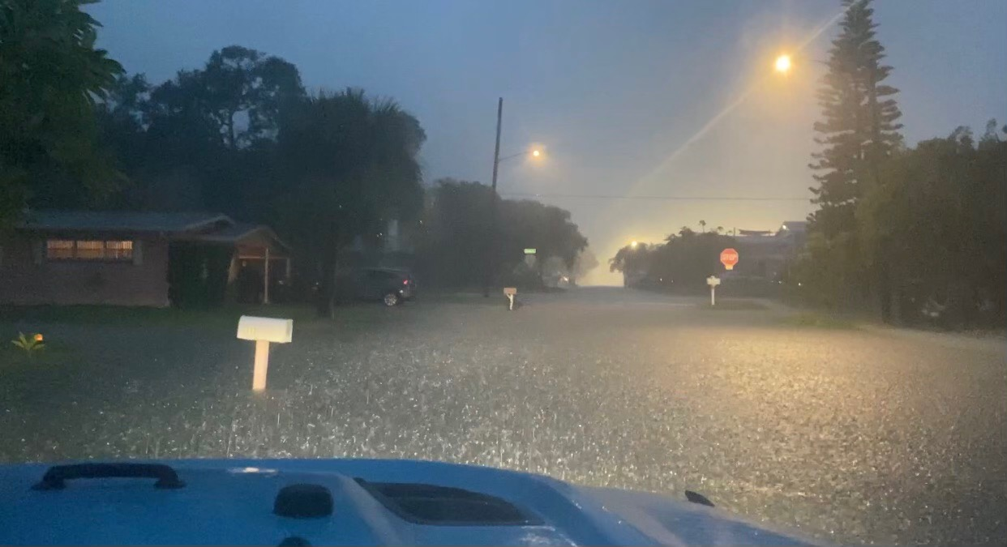
Fillmore Ave.: Severe urban street flooding via thunderstorm.

Slide 9
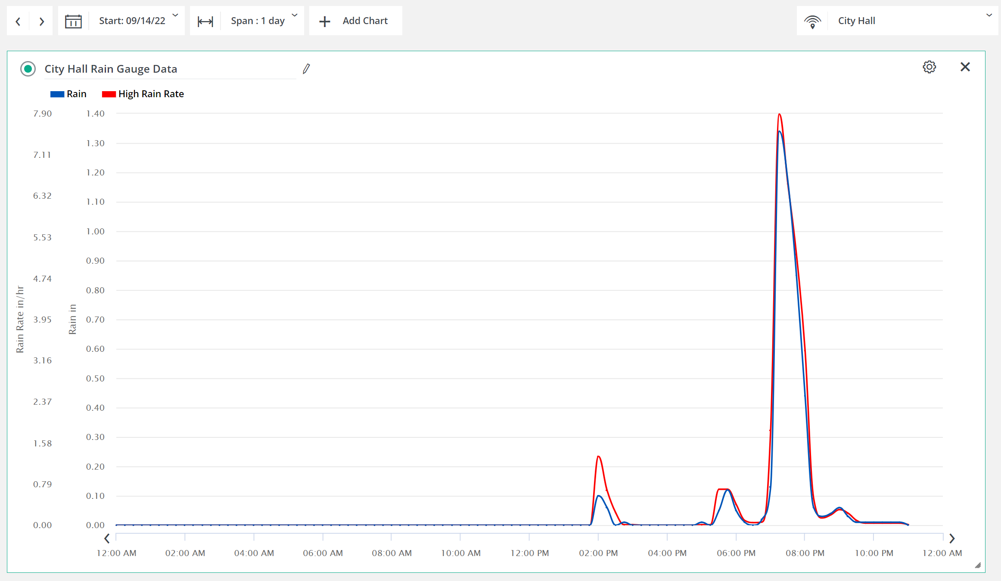

Slide 10
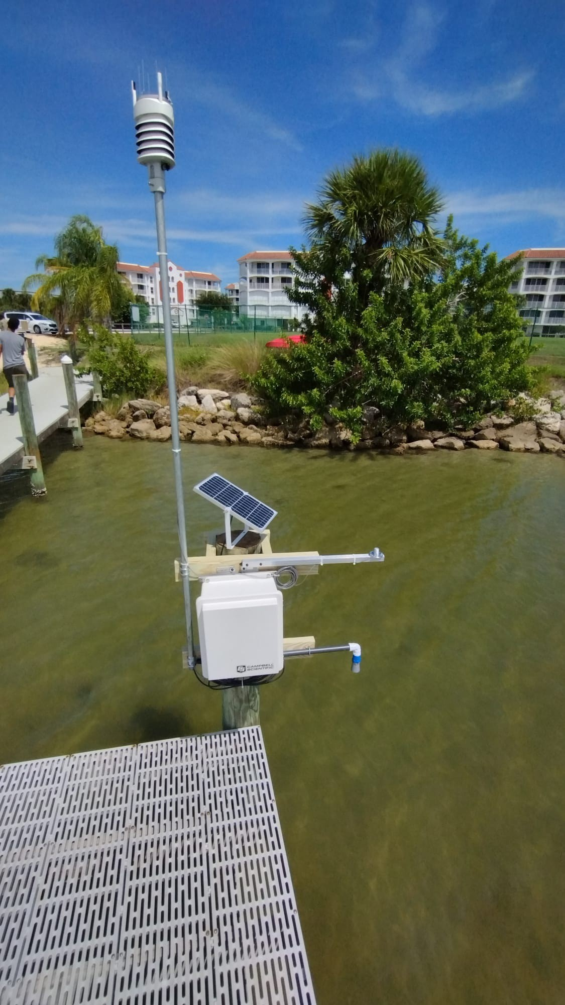
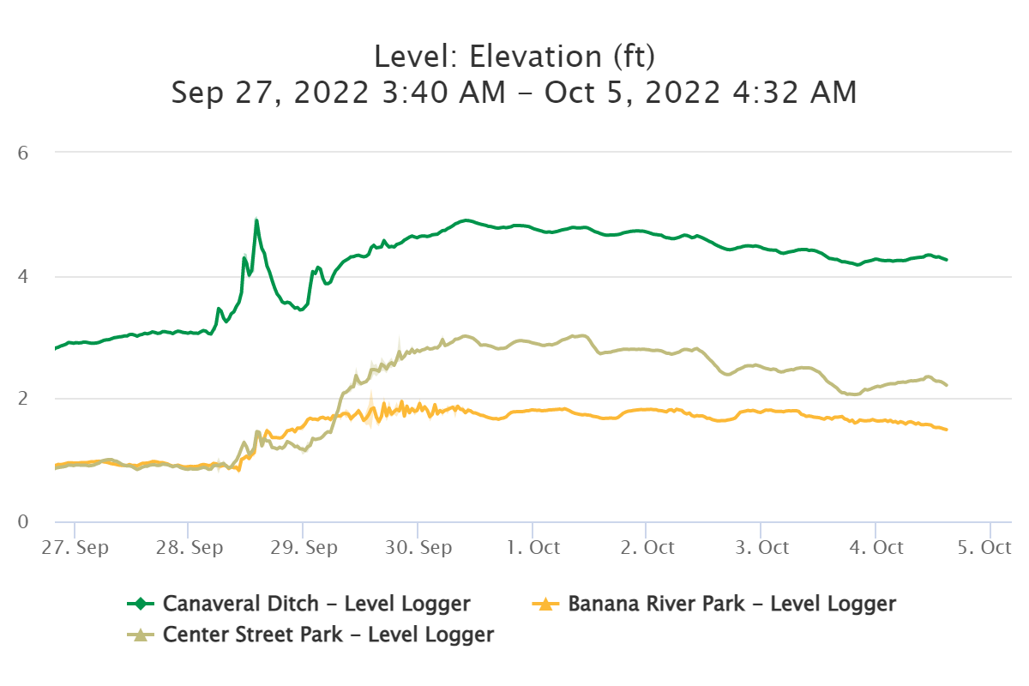
Hurricane Ian-related water rise recorded within the Banana River Lagoon by the City’s remote water level gauge network.

Slide 11
