Slide 1
Space Coast TPO Federal Certification Public Input Meeting May 3, 2022 |

Slide 2
Why are WE here?
The US DOT is required to certify the planning practices within the transportation management areas to determine how the region follows federal laws and regulations.
No less than once every 4 years FTA & FHWA jointly review the metropolitan transportation planning process for those areas over 200,000 in population (TMAs).

Slide 3
Why are YOU here?
Part of this review includes seeking the public’s input.
To solicit your comments and perspectives regarding the transportation planning and programming process, as carried out by the Space Coast TPO and its partners, including:
FDOT
Space Coast Area Transit
US DOT
Local Jurisdictions
Other Partners
Citizens

Slide 4
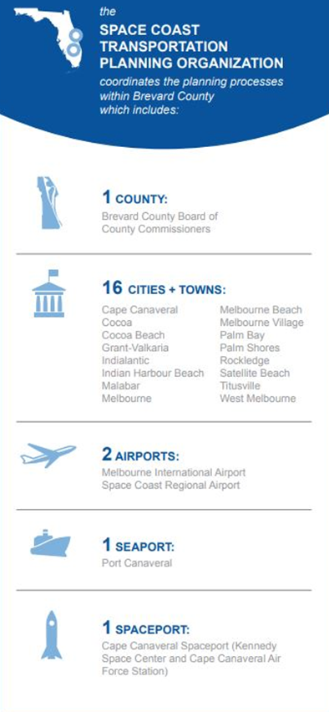
What is the Role of the SCTPO?
The Space Coast TPO is a forum for the board of local elected officials to:
coordinate transportation impacts and improvements
establish transportation policy
develop transportation plans to fix short and long-term needs
mutually agree on state- and federally-funded projects to improve regional mobility

Slide 5
Who informs our process?
*Sunshine Law applies to
ALL
SCTPO Governing Board and Committee Members
Notes:
Organizationally, we have four advisory committees to the TPO Governing Board: the Bicycle, Pedestrian, and Trails Advisory Committee, the Citizen’s Advisory Committee, and the Technical Advisory Committee. The Executive Committee reviews in detail key transportation policy and administrative issues of concern to the TPO. Public Involvement is encouraged throughout the process. Let’s take a closer look at each Committee.
--------------------------------------------------------------------------------------------------------------------------------------------------------------------------------------------------------------

Slide 6
Why is it important?
Decide how a substantial share of federal transportation funding is spent
Because of limited funding, the Space Coast TPO must collaboratively prioritize the regional needs and determine the best and most economical solutions
Provides the framework for the future transportation system

Slide 7
How is it Done?
3-C Approach
Continuing Cooperative Comprehensive
Multimodal - Public Input

Slide 8
Core Work Products
- Unified Planning Work Program (UPWP)
- Long Range Transportation Plan (LRTP)
- Congestion Management Process (CMP)
- Transportation Improvement Program (TIP)
- Public Participation Plan (PPP)

Slide 9
Relationship Between Core Products
Public Participation Plan
2045 Long Range Transportation Plan
Project Priorities
Transportation Improvement Program
Unified Planning Work Program

Slide 10
Metropolitan Transportation Planning Process
Comments?
Have you been involved in the MPO
transportation planning process? How?
What are the positive aspects of the TPO transportation planning process?
What suggestions do you have for improving the TPO transportation process?

