Slide 1
Public Participation Plan
Performance Measures Report
July 2020 - June 2021
Presented By:
Abby Hemenway, Public Involvement Officer
321-350-9261
Abby.Hemenway@brevardfl.gov

Slide 2
Tracking Public Participation
Public Participation Methods
Public Face-to-Face or Virtual Meetings
Public Workshops/Open Houses/ Webinars (New!)
Public Events/Presentations
Title VI/Nondiscrimination Complaints
Public Participation Tools
Surveys/questionnaires
SCTPO Electronic Newsletters
SCTPO Email Marketing Campaigns
SCTPO Website
Social Media Channels

Slide 3
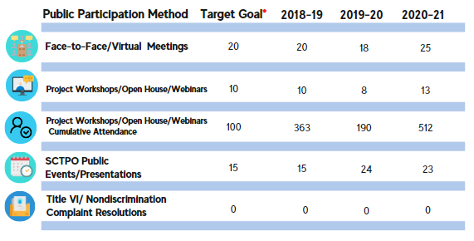
Public Participation Methods Goals Summary
***Our goal target numbers are simply a general target. Actual numbers for each category may fluctuate depending on the year due to the cycle of projects/plans, unforeseen circumstances, or states of emergency.

Slide 4
The Impacts of Social Media
According to Statista, there are 3.78 billion social media users worldwide in 2021 – and this number is only going to continue growing over the next few years (Statista, 2020). As it stands, that equates to about 48 percent of the current world population.
Social Media Definitions
Facebook Reach: The number of unique people who have seen any content associated with your page.
Twitter Impression: The number of times users saw the tweet on Twitter.
YouTube View: YouTube counts a view after a user has watched a video for “around” 30 seconds.
Nextdoor Impression: the number of residents who viewed a post in their newsfeed, the number of opens of email notifications that are sent when a public agency posts to Nextdoor, and the number of clicks on an agency's post in the Daily Digest.
Notes:
The latest social media statistics in 2021 show that an average of two hours and 25 minutes are spent per day per person on social media (DataReportal, 2021).
As social media is becoming more integrated into our daily lives, it unveils countless opportunities for businesses who are looking to reach out to their audience through social media marketing.

Slide 5
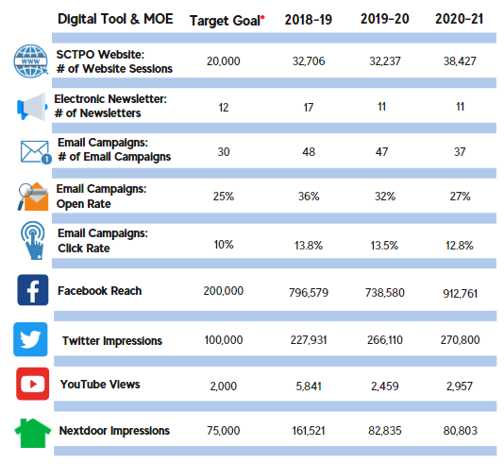
Measures of Effectiveness
The public participation Measures of Effectiveness analyzes and quantifies the tools the SCTPO uses to inform and involve the public in transportation planning, with the purpose of maximizing participation and engagement.
***Our goal target numbers are simply a general target. Actual numbers for each category may fluctuate depending on the year due to the cycle of projects/plans, unforeseen circumstances, or states of emergency.

Slide 6
Engaging Underserved Populations
In order to provide equitable public participation, appropriate messages
and delivery techniques are developed for project specific studies and plans
with vital stakeholders, as needed, to ensure meaningful communication and
dialog is established for all projects and plans.
Target Outreach Groups
Brevard County Housing and Human Services
Brevard Public Schools
Brevard County Libraries
Churches and Religious Organizations
Local Government and Civic Leaders
Nonprofit Organizations
Senior Centers and Assisted Living Communities
Social Service agencies, Groups and Organizations
Transportation Carriers
Transportation Disadvantaged Local Coordinating Board
Transit Riders

Slide 7
QUESTIONS?
Contact Information:
Abby Hemenway, Public Involvement Officer
321-350-9261
Abby.Hemenway@brevardfl.gov

